Slide 1


A Computationally Efficient Platform to Examine the Efficacy of Regional Downscaling Methods
AGU Fall Meeting
Abstract GC12C-04
Jonathan L. Vigh¹, Caspar M. Ammann¹, Richard B. Rood²,
Joseph J. Barsugli³, and Galina Guentchev¹
1. Climate Science and Applications Program, Research Applications Laboratory, NCAR
2. University of Michigan
3. CIRES/University of Colorado Boulder
http://earthsystemcog.org/projects/ncpp/
Notes:
This is a “beginning of project” presentation.

Slide 2
The Problem
Ever-expanding sets of climate projections
Proliferation of downscaling methods
Need for translation: application- and discipline-specific metrics
Need for standardization and interoperability with other tools
Need for high level of extensibility
Need for evaluation

Slide 3
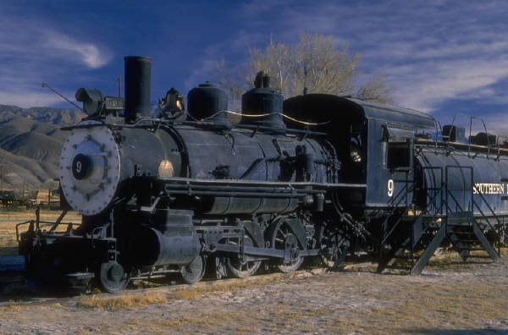
The Solution:
Quantitative Evaluation
The NCPP team is working:
To advance community-coordinated provision of regional and local knowledge about the evolving climate
To accelerate its use in adaptation planning an decision making
Facilitating the development of application-oriented communities
Developing standards, recommendations and guidance for use of localized climate predictions & projections
Developing a flexible evaluation platform that offers performance metrics on methods, data and tools.
The Evaluation Engine

Slide 4
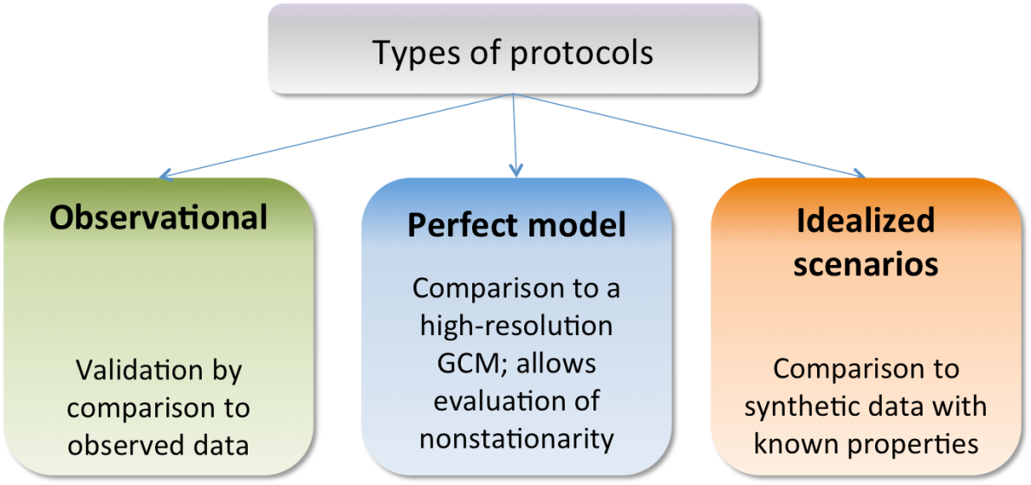
Evaluation Framework
We have initially focused on evaluation of present observed climate
aiming to evaluate the different attributes of the various
downscaling methods
Notes:
The evaluation needs to have relevance for practitioners to help guide the selection and use of climate projections.
Evaluation should address the scientific issues that the downscaling methods raise:
Do dynamical methods accurately simulate processes that are important for regional climate features?

Slide 5
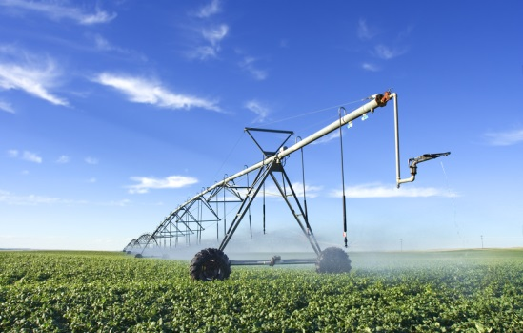
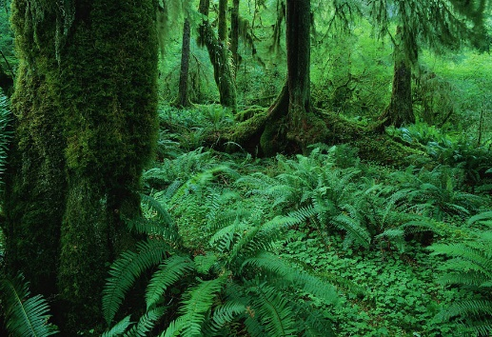
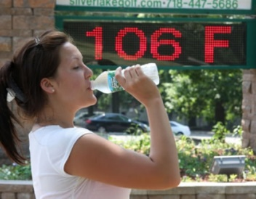
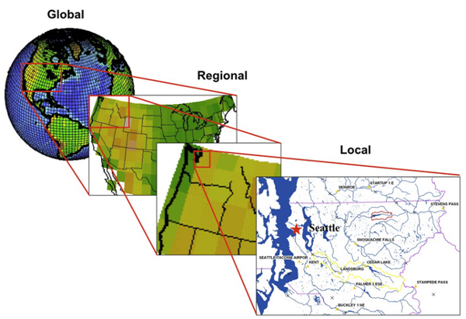
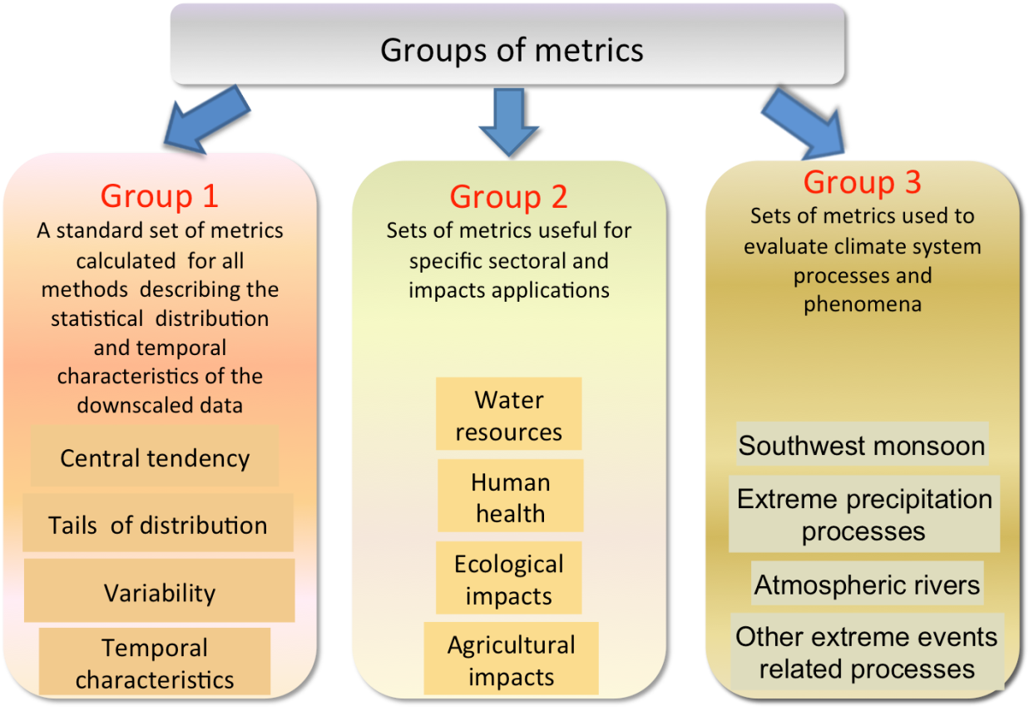
Agriculture
Water
Resources
Ecosystems
Human Health
Mean
Max
Min
p5
p10
p25
Median
p75
p90
p95
St Dev
Downscaling
ETCCDI Extremes Indices
Human Health Indices
BIOCLIM Indices

Slide 6
Data Challenges
Lack of standardized data:
Differing metadata
Different calendaring systems
Missing coordinate arrays
4.4 GB files of daily surface data:
Tas, TasMax, TasMin, Pr, DTR
1971-2000
Lower 48 U.S.
Nearly 1 TB of input data
Observational Input Datasets
Maurer02v2 (12 km)
Maurer02v2 (regridded to 50km)
Daymet2.1 (regridded to 12km)
Types of Model Input Datasets
Asynchronous Regional Regression Model
(ARRM) at 12 km from 16 GCMs
Bias-Correction Constructed Analogs (BCCA) at 12 km from 10 GCMs
Dynamical Downscaling
  NARCCAP at 12 and 50 km
Perfect Model w/ ARRM & Perfect Model Target
Coming soon: Univ. of Delaware, Berkeley Earth, etc. + more fields (variables)

Slide 7
Data Flows: Incremental Processing
Input Data
Restructuring
Base Statistics
Aggregated Climatology Datasets
Evaluation Datasets
4.4 GB files of 30 years of daily data:
-Temperature
-Max Temp
-Min Temp
-Precipitation
-Diurnal Temperature Range
Restructure daily data into period x day:
-Monthly
-Seasonal
-Annual
-Decadal
Timing:
18 min
Compute base statistics for each period:
Mean/max/min
-Sum (precip)
-Extreme Indices
-Counts of threshold-based indices
Timing:
44 min
Compute period statistics:
-Period mean
-Standard deviation
-Period quantiles (p5, p10, p25, p50, p75, p90, p95)
-BioClim indices
Timing:
4 min
Output individual datasets, visualizations, and XML metadata
-1587 datasets
-CF-conforming NetCDF output
-Full image metadata with data provenance information
-Visualization with customized color maps
Timing:
~90 min
Comparison Datasets
Compute comparison datasets
3 protocols:
- Observations
- Perfect model
-Idealized scenarios
Current metric:
-Bias
Future metrics:
RMSE
Timing:
~90 min – 270 min
Engine implemented in NCAR Command Language (NCL)
Automated job submission allows for massive parallel processing
Open Climate GIS

Slide 8
Metadata Standards
The result of the evaluation & comparison is ~159,000 plots and datasets
NCPP Team has developed metadata descriptors and standards
Common Information Model (CIM) developed by Earth System Model Documentation (ES-DOC) Project
New controlled vocabulary for regional downscaling to describe the eval & and comparison
Descriptors agreed upon by larger team (NASA/NOAA/Euro-CORDEX)
Metadata facilitates capability for finding, accessing and using the products using the controlled vocabulary:
For search, access and comparison
Either through web interface or through machine search by tapping into the Earth System Grid Federation (ESGF)
For the first time, all products come with full metadata info
Success stories
Using these descriptors, the GFDL group published the Perfect Model on their ESGF node
Nasa AIMES team published the new 800 m BCSD on their node

Slide 9
Metadata Standards
The result of the evaluation & comparison is ~159,000 plots and datasets
NCPP Team has developed metadata descriptors and standards
Common Information Model (CIM) developed by Earth System Model Documentation (ES-DOC) Project
New controlled vocabulary for regional downscaling to describe the eval & and comparison
Descriptors agreed upon by larger team (NASA/NOAA/Euro-CORDEX)
Metadata facilitates capability for finding, accessing and using the products using the controlled vocabulary:
For search, access and comparison
Either through web interface or through machine search by tapping into the Earth System Grid Federation (ESGF)
For the first time, all products come with full metadata info
Success stories
Using these descriptors, the GFDL group published the Perfect Model on their ESGF node
Nasa AIMES team published the new 800 m BCSD on their ESGF node

Slide 10
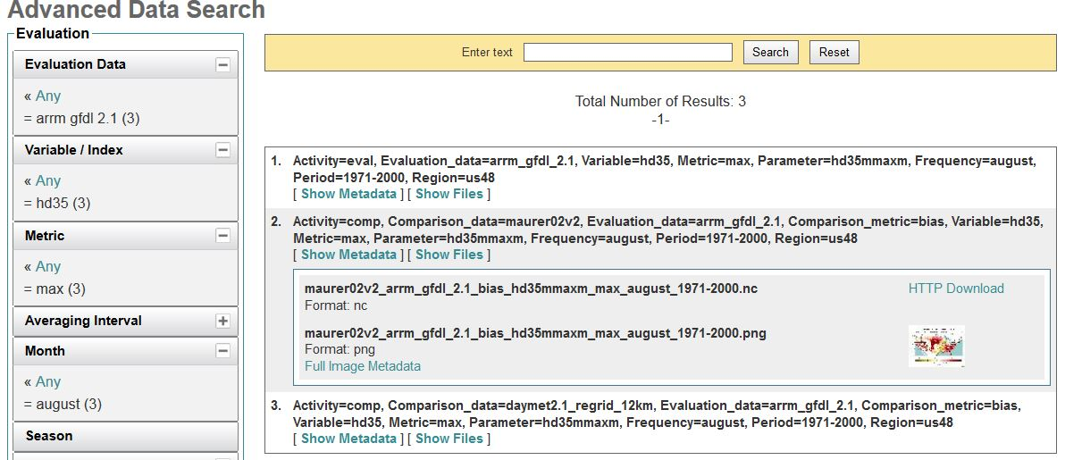

CoG Advanced Data Search:
Evaluation Database and Metadata
Directory structure utilizes the metadata schema with one unique dataset at the end of each branch:
  the NetCDF dataset
  the XML metdata
  the visualization (png)
Notes:
Evaluation Database populated with files that are mostly indices
COG / NESII / Standardized and Objective /

Slide 11
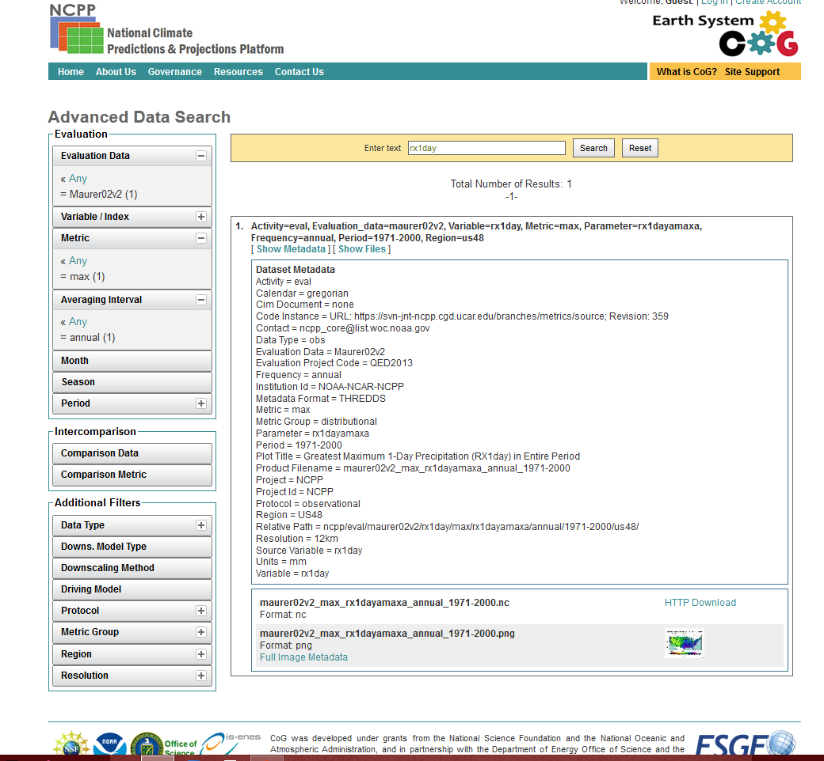
http://earthsystemcog.org/search/downscaling-2013/

Slide 12
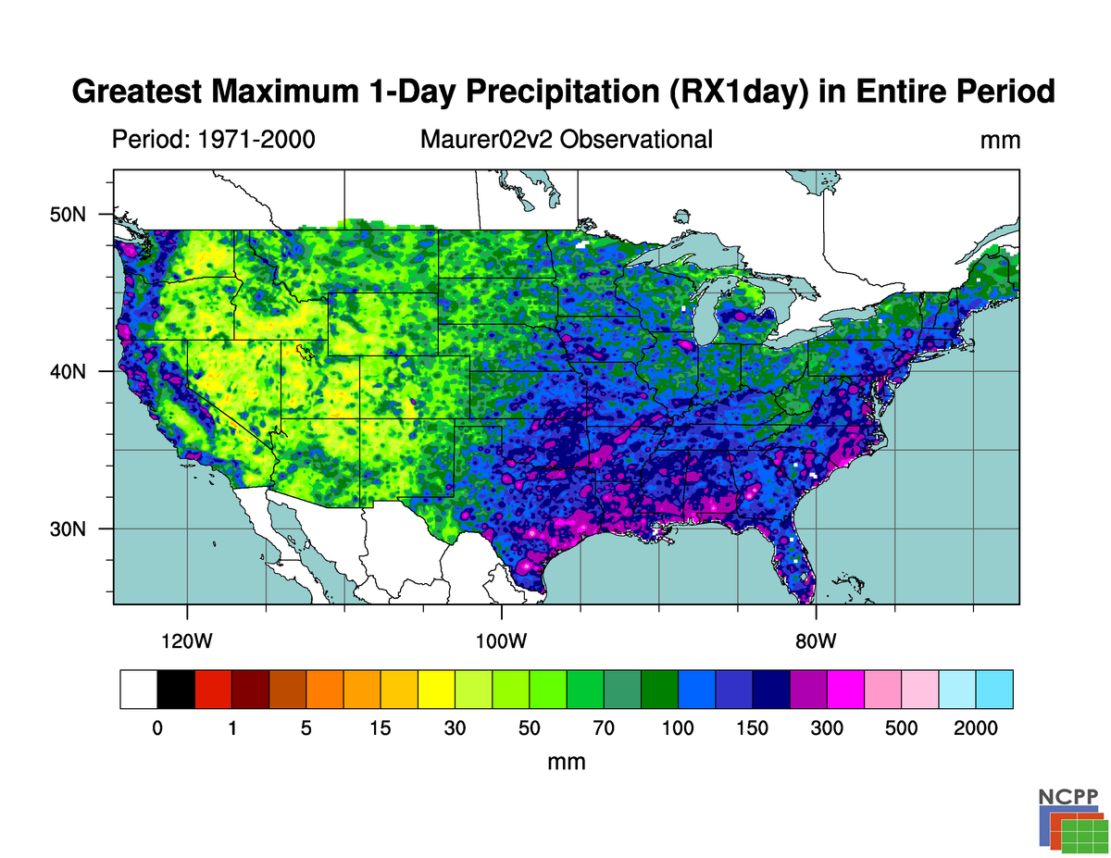

Slide 13
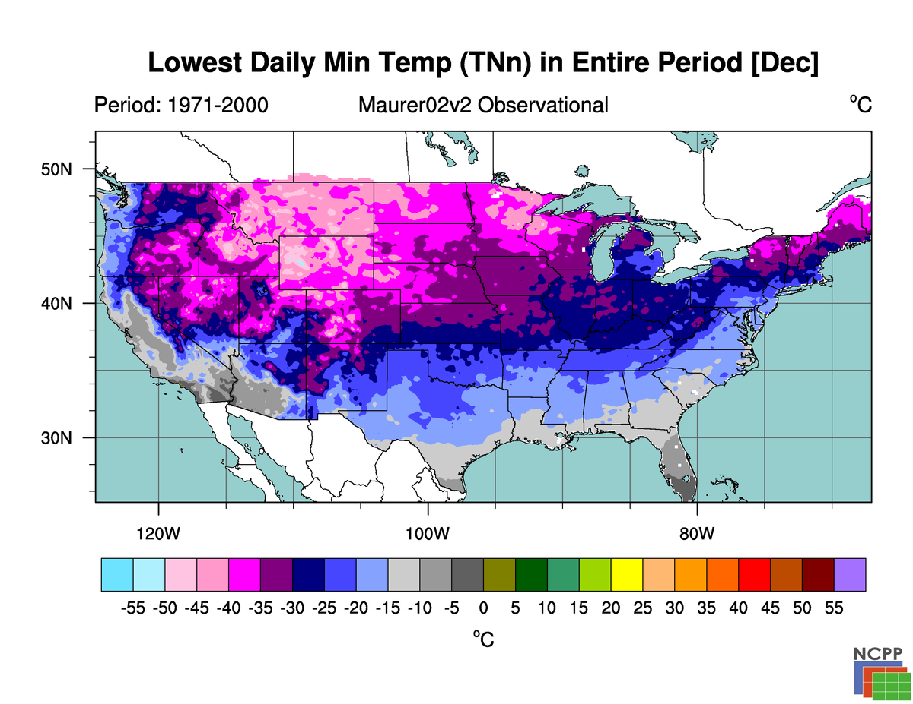

Slide 14
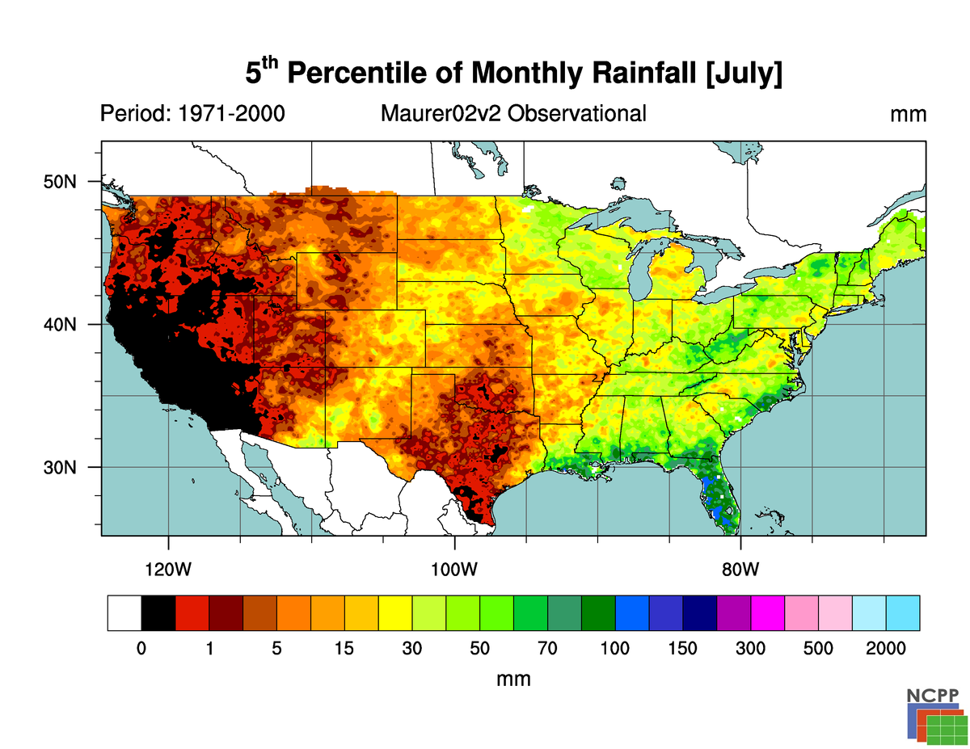

Slide 15
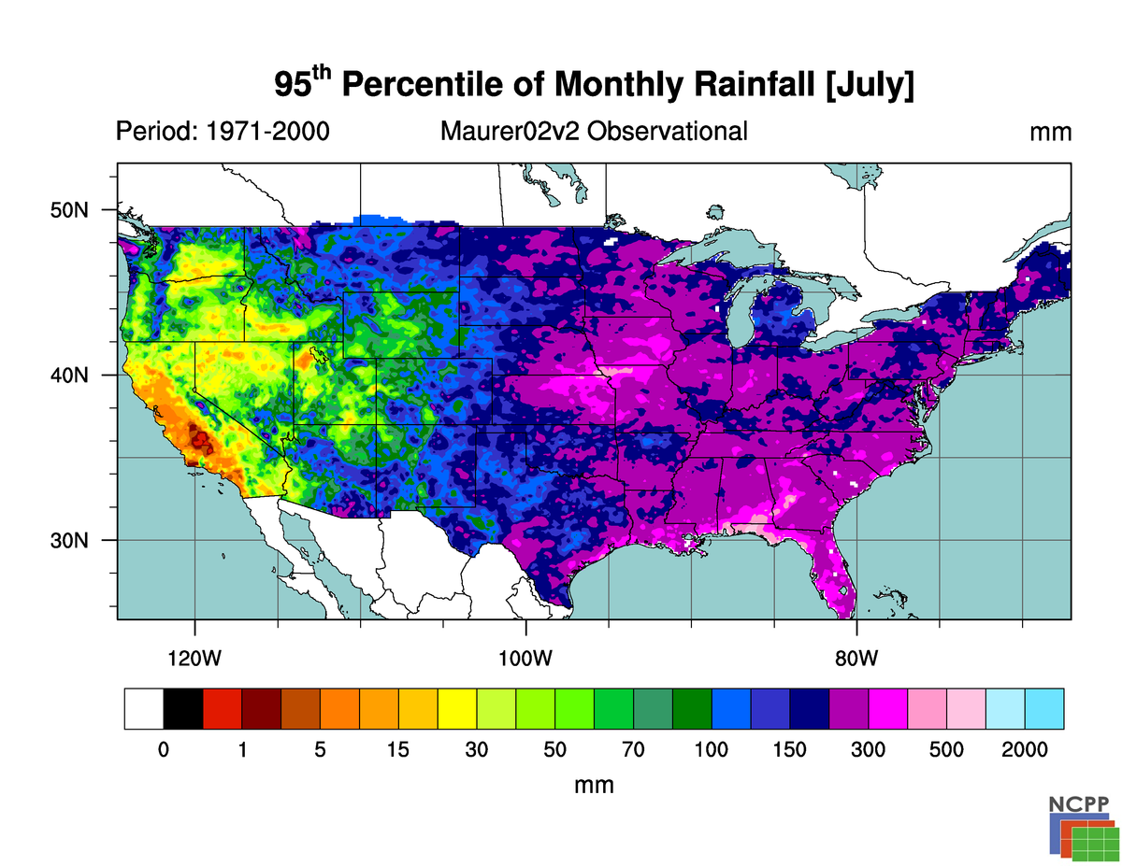

Slide 16
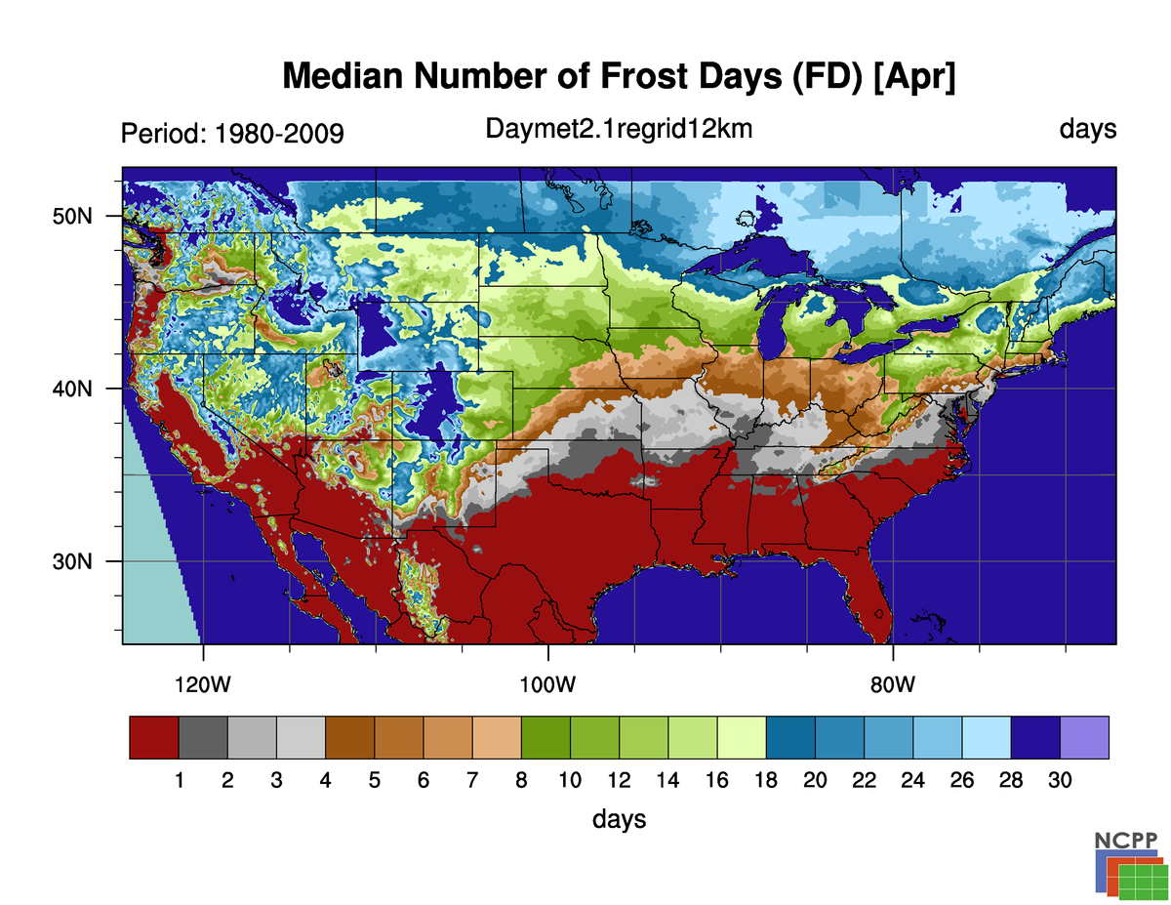
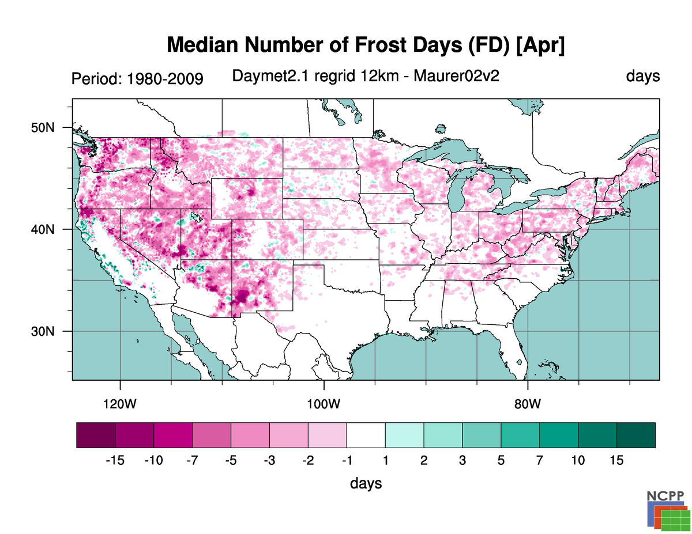

Slide 17
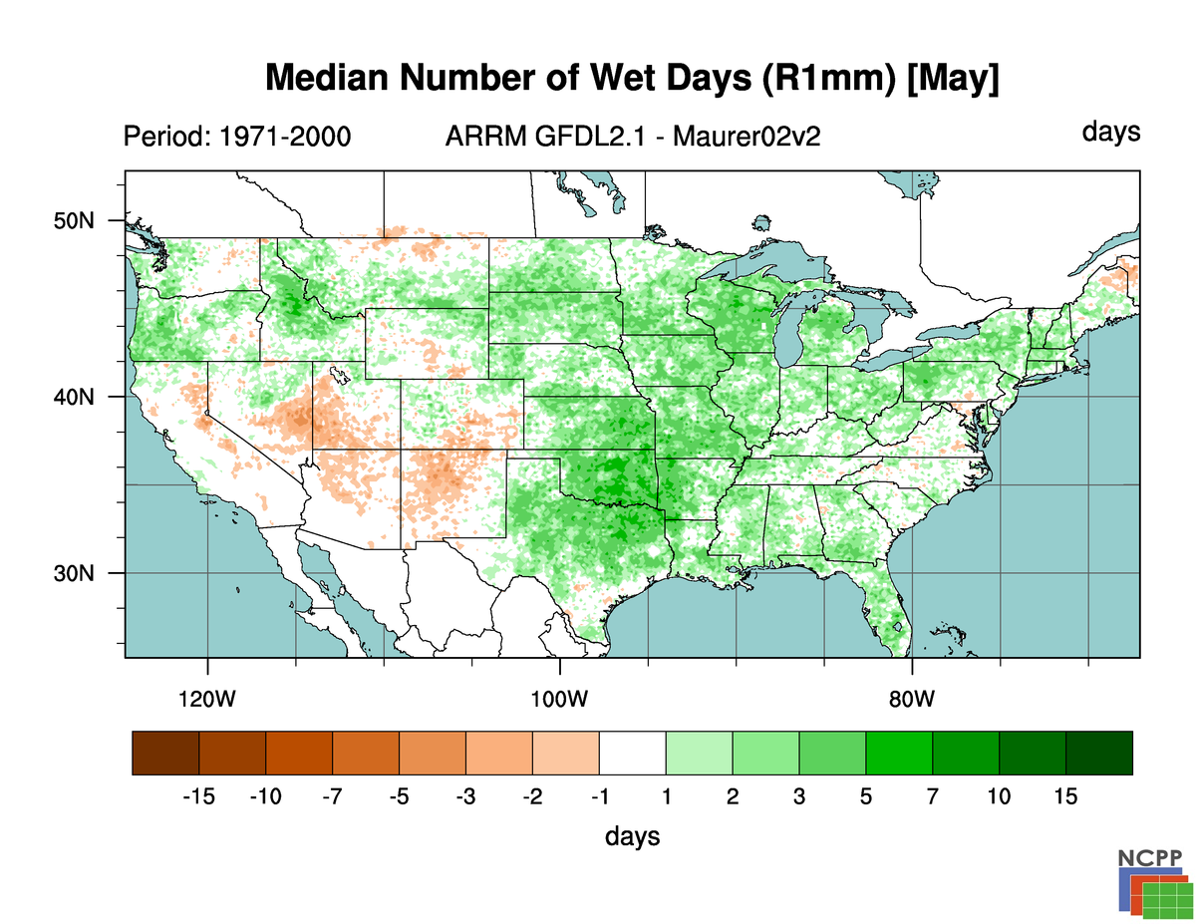

Slide 18
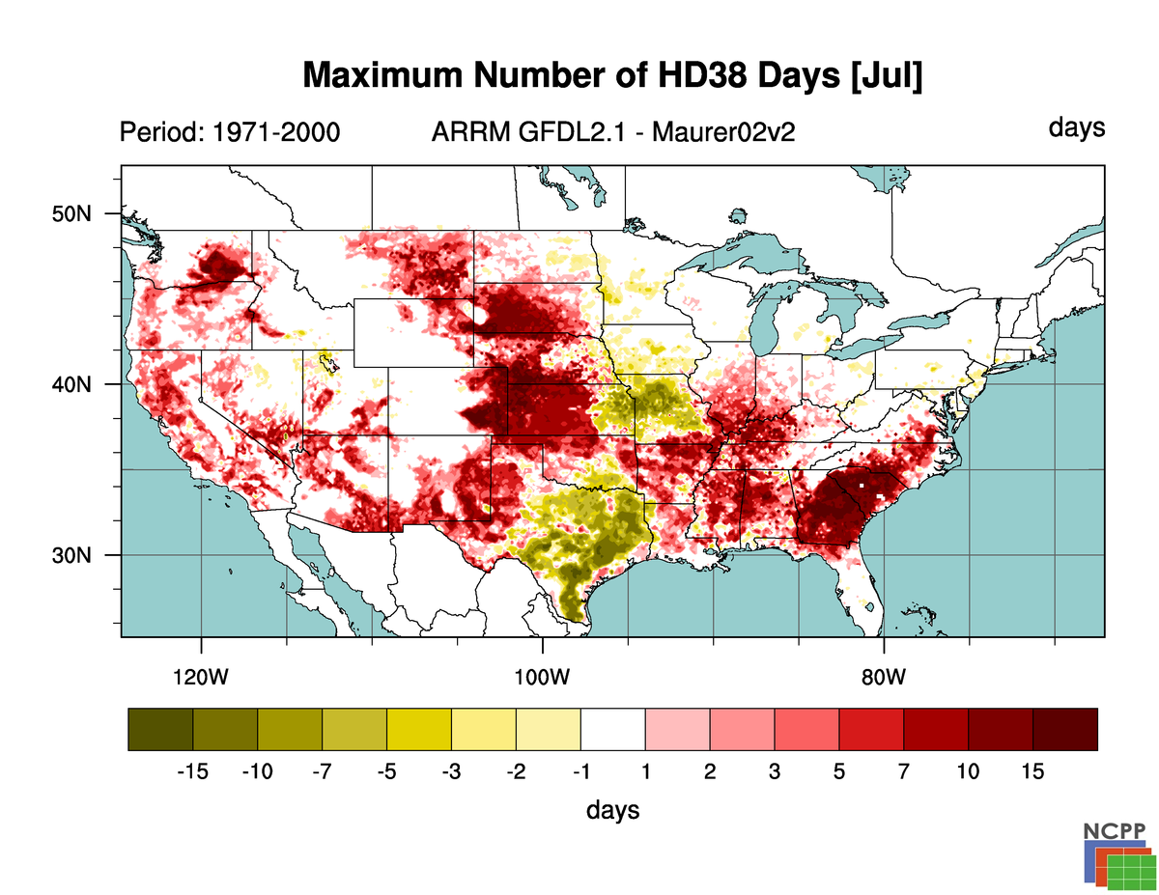
Means are often relatively well represented, but differences towards the tails of distributions, extremes are vital to understand

Slide 19
Summary
Benefits of the evaluation engine:
Highly efficient, flexible, extensible, interoperable with end-to-end parallelized workflow
Implemented with standards and metadata allowing comprehensive search
  Allows users to get the information they need by reducing content
Gives users information about the properties of the climate data
  Both distribution and uncertainty
Makes the production and assumptions of the data transparent

Slide 20
Future Capabilities
Examples of future directions under consideration:
Ensembles (Gradient-preserving? Optimum blending?)
Extreme value analysis (e.g. return periods)
More application group-related indices and more user groups
On-demand (precalculated) vs. on-the-fly capability
More user-friendly interface with curated discipline-specific ‘collections’
Intercomparison of future projections
NCPP needs your input:
NCPP website:
NCPP evaluation & comparison data:
http://earthsystemcog.org/projects/ncpp/
http://earthsystemcog.org/search/downscaling-2013/

Slide 21
Listing of All Indices
» bioclim1 (1)
» bioclim2 (1)
» bioclim3 (1)
» bioclim4 (1)
» bioclim5 (1)
» bioclim6 (1)
» bioclim7 (1)
» bioclim8 (1)
» bioclim9 (1)
» bioclim10 (1)
» bioclim11 (1)
» bioclim12 (1)
» bioclim13 (1)
» bioclim14 (1)
» bioclim15 (1)
» bioclim16 (1)
» bioclim17 (1)
» bioclim18 (1)
» bioclim19 (1)
» fd (52)
» hd30 (52)
» hd35 (52)
» hd38 (52)
» hd40 (52)
» hd45 (52)
» id (52)
» r10mm (52)
» r1mm (52)
» r20mm (52)
» rx1day (52)
» sd (52)
» tnn (48)
» tnx (48)
» tr (52)
» txn (48)
» txx (48)
tas
tasmax
tasmin
pr
dtr

