Slide 1

Impact of Traditional and Non-traditional Observation Sources using the Grid-point Statistical Interpolation Data Assimilation System for Regional Applications
Kathryn Newman^{1,2}, Ming Hu^{1,3}, Christopher Williams^{1,2}, Chunhua Zhou^{1,2} and Hui Shao^{1,2}
¹ Developmental Testbed Center (DTC)
² National Center for Atmospheric Research (NCAR)
³ NOAA/Global Systems Division
Acknowledgement: Air Force Weather Agency (AFWA)
95st AMS Annual Meeting/19th IOAS-AOLS Phoenix, AZ January 5-9

Slide 2
Overview
As new sources of traditional/non-traditional data become available for GSI, the DTC tests the utility of the new dataset(s) by conducting sensitivity tests for regional scale model forecasts
Provide recommendations to AFWA concerning:
  GSI DA configurations that optimize the utility of these data
  Datasets that best enhance GSI performance
Impact on operational observation suite for proposed increase in model top
Sensitivity testing for non-traditional data sources:
  NOAA-16/17/19 SBUV/2 (Ozone)
  METOP-A GOME-2 (Ozone)
Notes:
State that GSI cannot assimilate these data yet, more details on slide at end of presentation.

Slide 3
Experiment Design
GSI v3.3 (3d-var) coupled with WRF-ARW v3.6.1
  Partial cycling scheme – cold start 06/18, warm start 12/00
Testing period: 2014 August 1-31
  Observations assimilated: AFWA conventional observations, GPS RO, satellite radiances (AMSU-A, MHS, AIRS, HIRS4, IASI, CrIS)
    continuously cycled BC coefficients
15 km horizontal resolution, 62 (57) vertical levels, 2 mb (10 mb) model top
48-hr deterministic forecasts initialized at 00/12
Verification against ERA-Interim reanalysis using Model Evaluation Tools (MET)
Atlantic Domain – GOME
E. Pacific Domain – SBUV

Slide 4
Experiment Design
End-to-end system configured to closely match AFWA operational suite
Model top test
Motivation: determine improvement/degradation from increasing model top in current operational suite from 10 to 2 hPa.
  CTL10: control (AFWA operational configuration*) w/ 10 hPa model top
  CTL02: CTL10 with increased model top to 2 hPa
    v3.6.1 updates for stratospheric lapse rate applied
Ozone Analysis
Motivation: explore use of ozone data in GSI/ARW for regional applications
Caveat: O₃ not forecast variable in ARW, therefore testing indirect effect on radiances through CRTM calculation
  SBUV: CTL02 with Solar Backscatter Ultraviolet (SBUV/2; v8) profile O₃
    NOAA 19
  GOME: CTL02 with Global Ozone Monitoring Experiment (GOME-2) total O₃
    Metop-a, Metop-b
GFS ozone used for background
* RRTMG used rather than AFWA operational radiation (rrtm/Dudhia)

Slide 5
Model Top Test
CTL 02 vs. CTL 10
Verification using ERA-I
Notes:
Need to add a few verification slides once complete. Test is running (control w/o CrIS complete), need to complete verification – should be done Wednesday

Slide 6
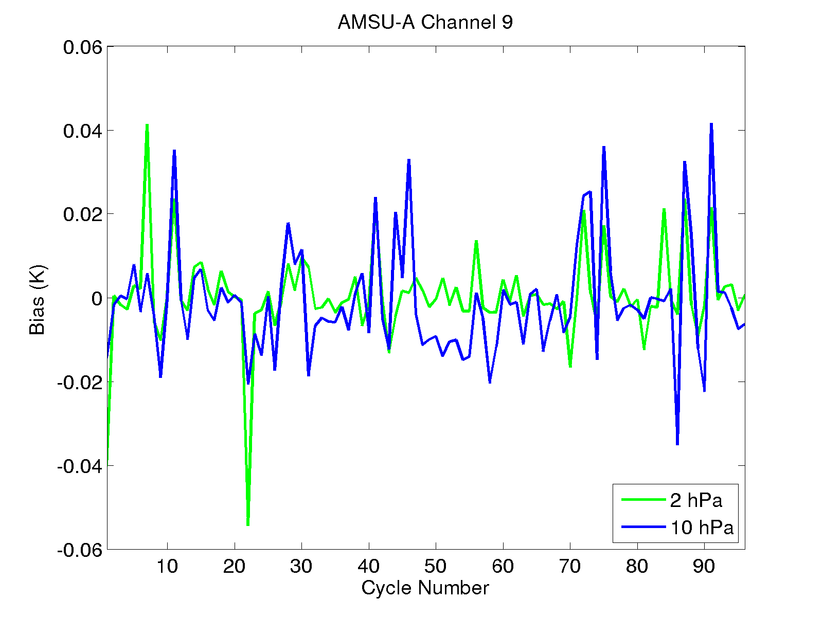
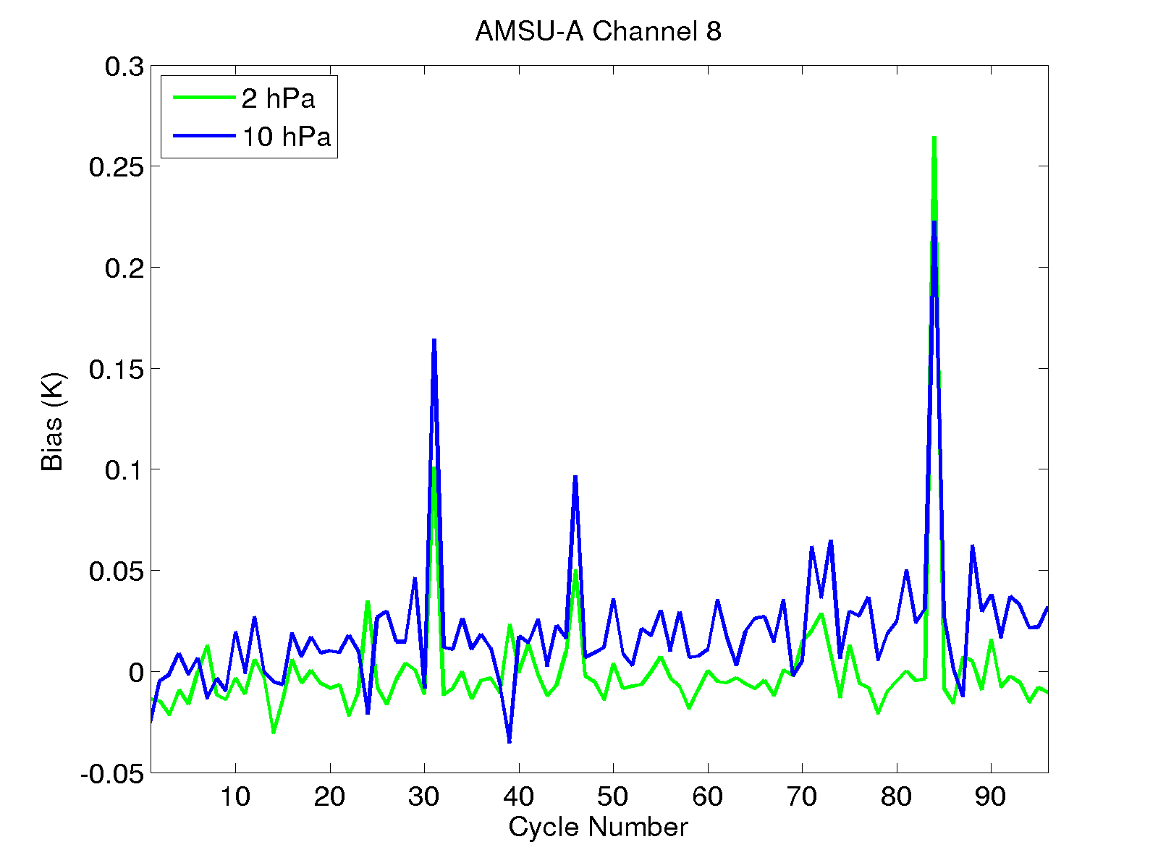
Model top test: analysis increment
O-A for high peaking AMSU-A channels
2 hPa run assimilates minimally more radiances relative to 10 hPa run
  Additional channel selection for 2 hPa
2 hPa O-A has smaller bias than 10 hPa
Notes:
Need to add a few verification slides once complete. Test is running (control w/o CrIS complete), need to complete verification – should be done Wednesday

Slide 7
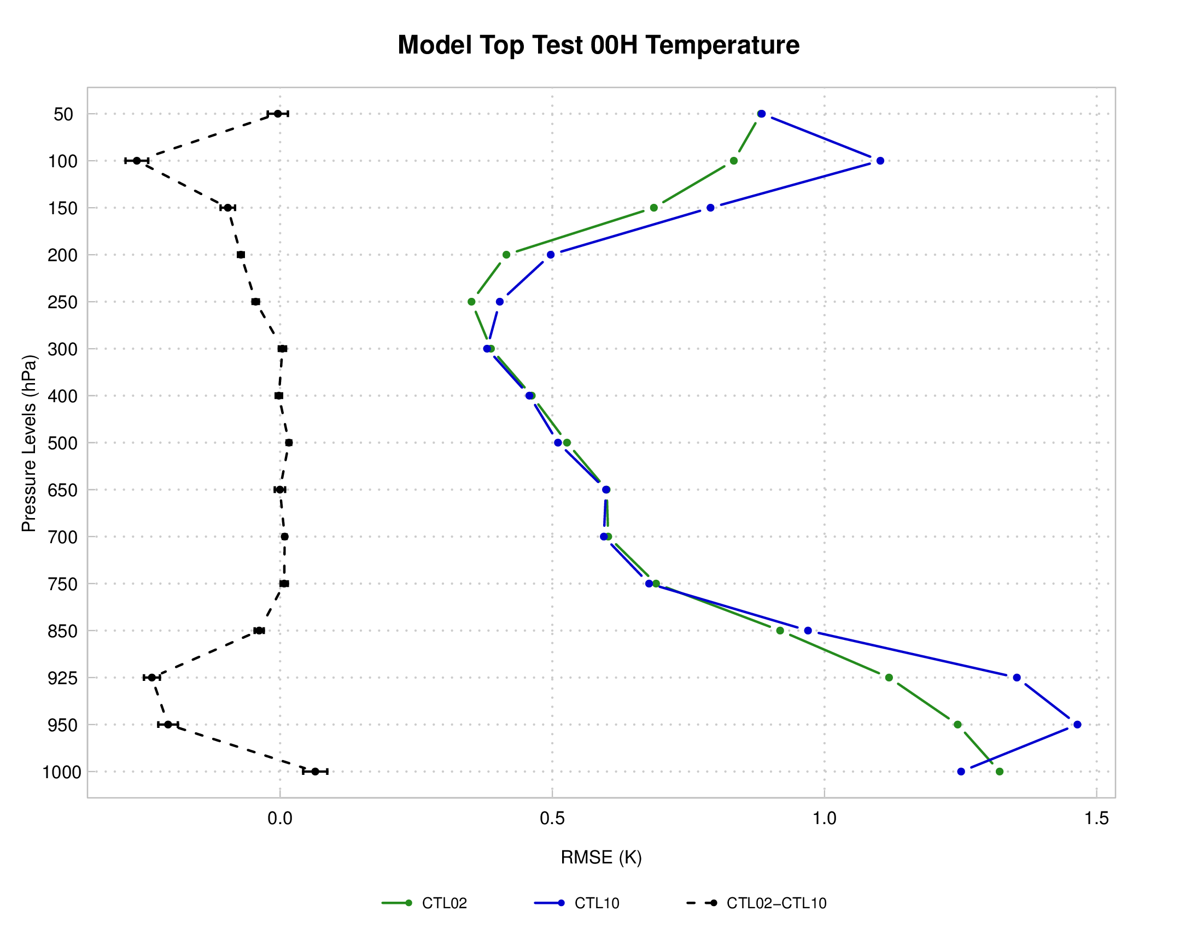
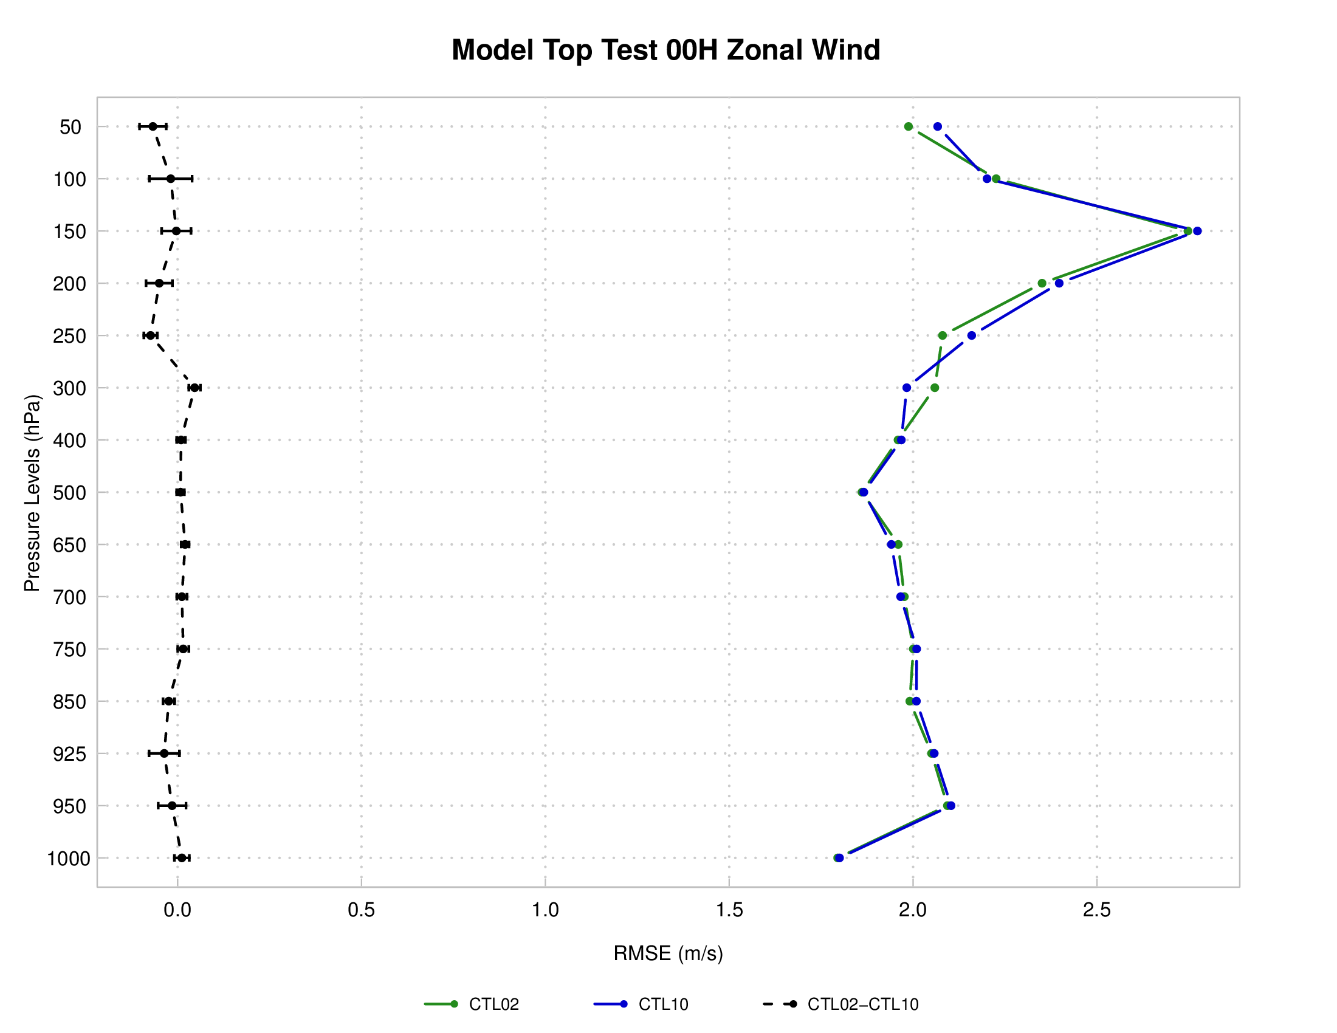
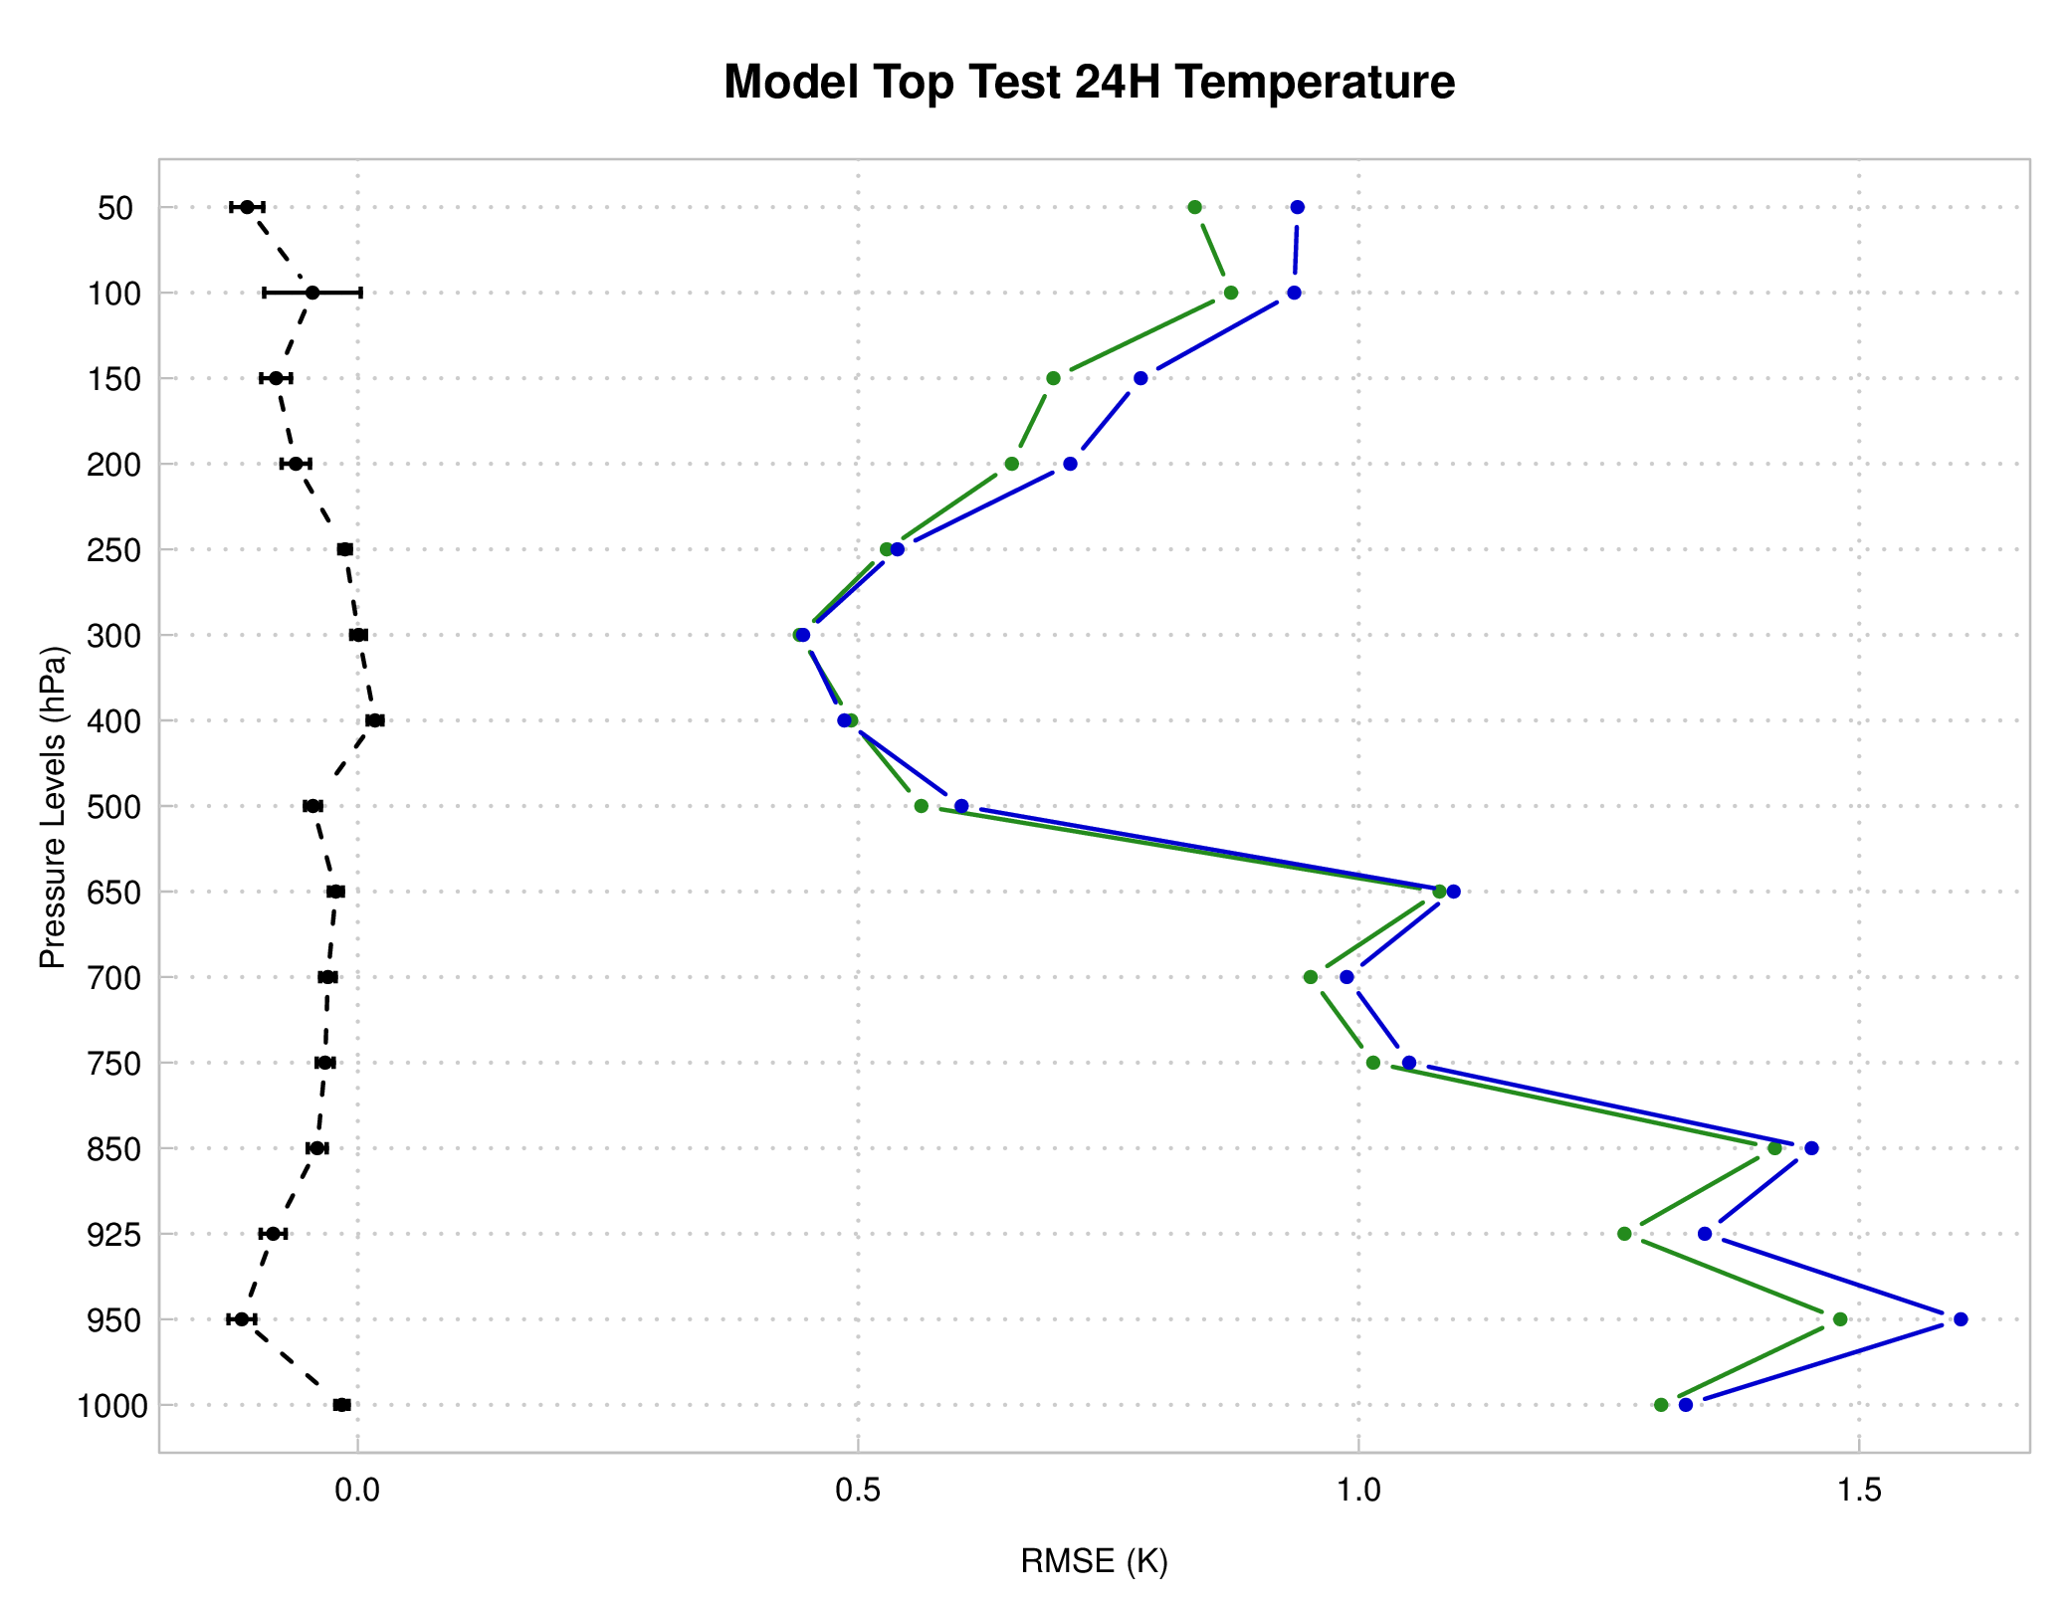
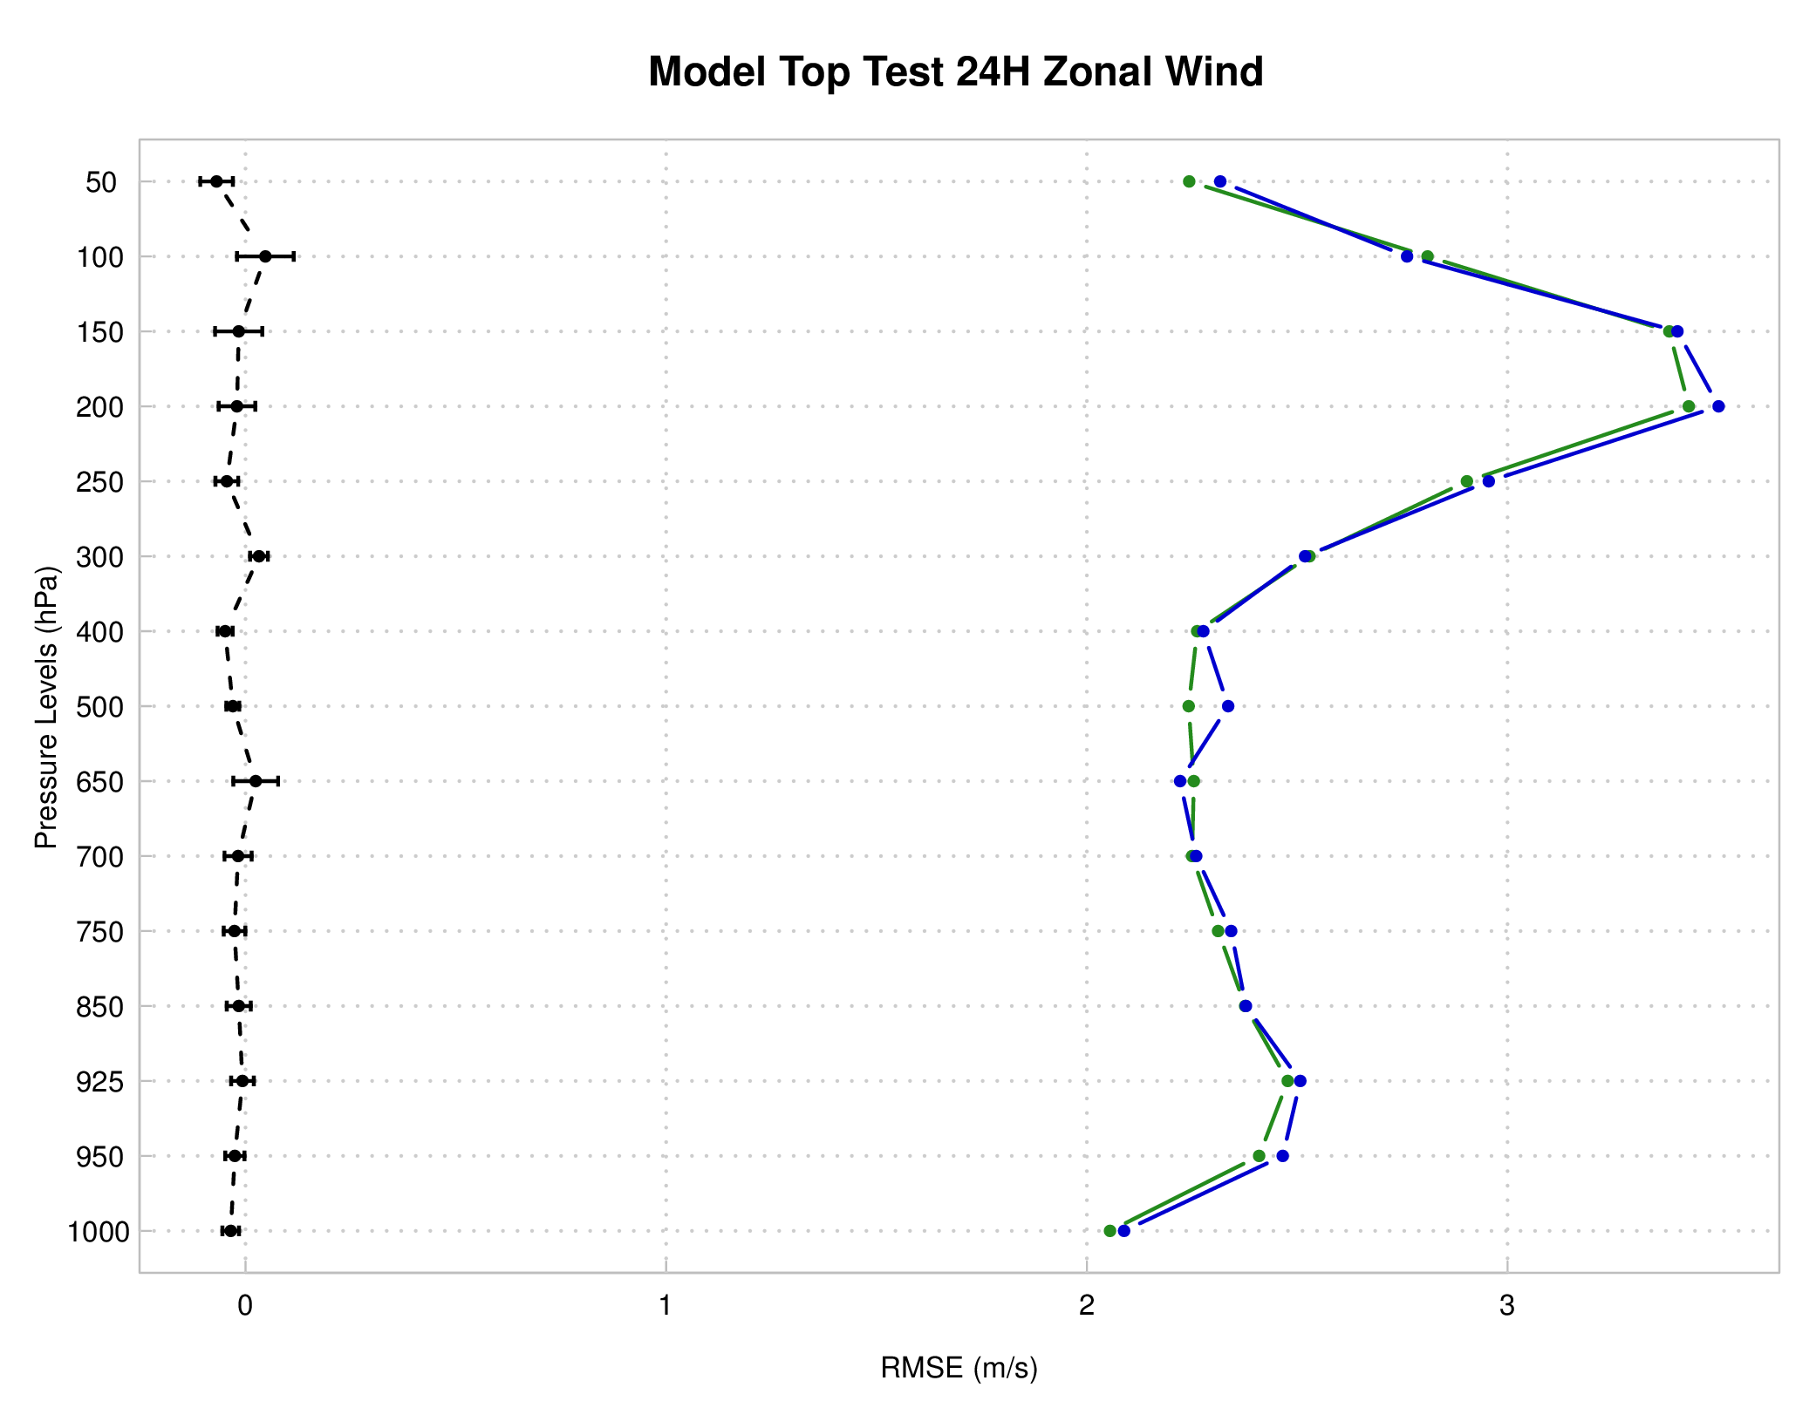
Model top test: verification against ERA-I
Analysis
2 hPa upper and lower level T field consistent improvement over 10 hPa run
SS improvements still present for 24-h forecast
U field sporadic SS improvements, few SS degradations
T
U
24 h forecast
T
U
CTL02 CTL10 CTL02-CTL10 (pairwise)

Slide 8
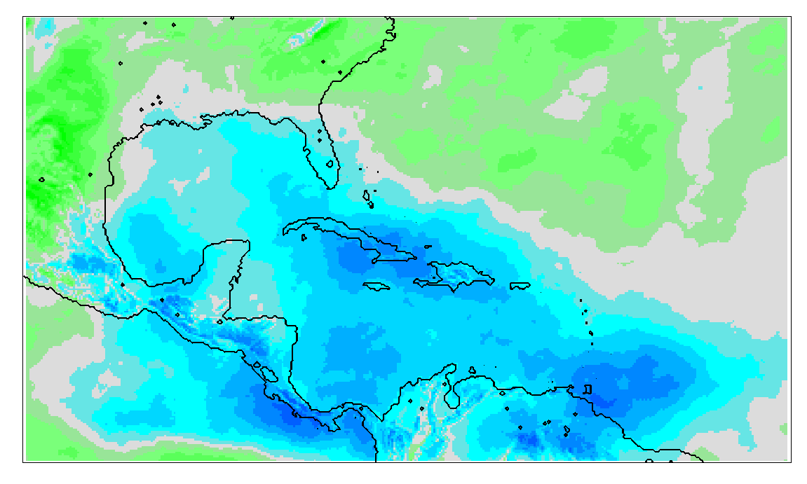
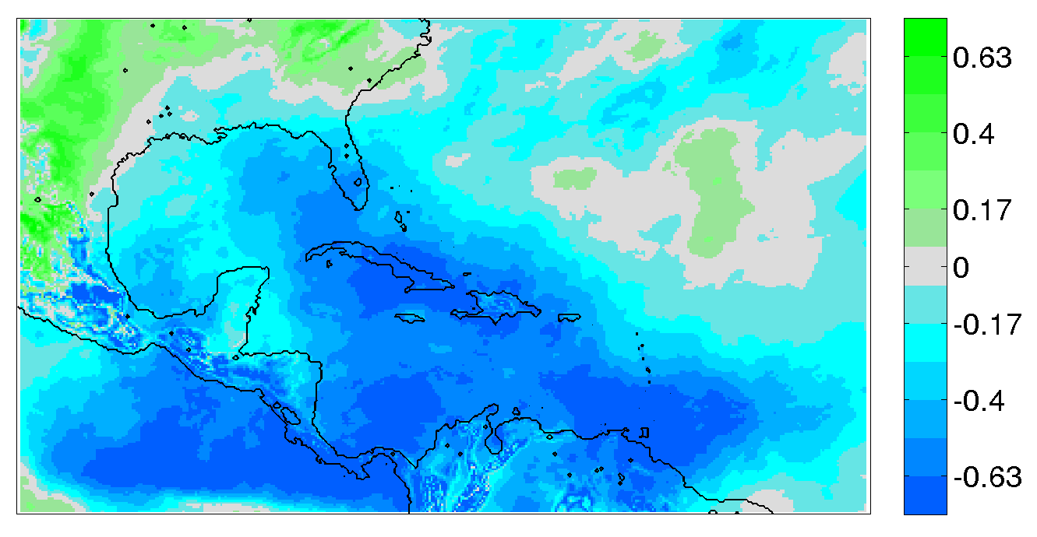
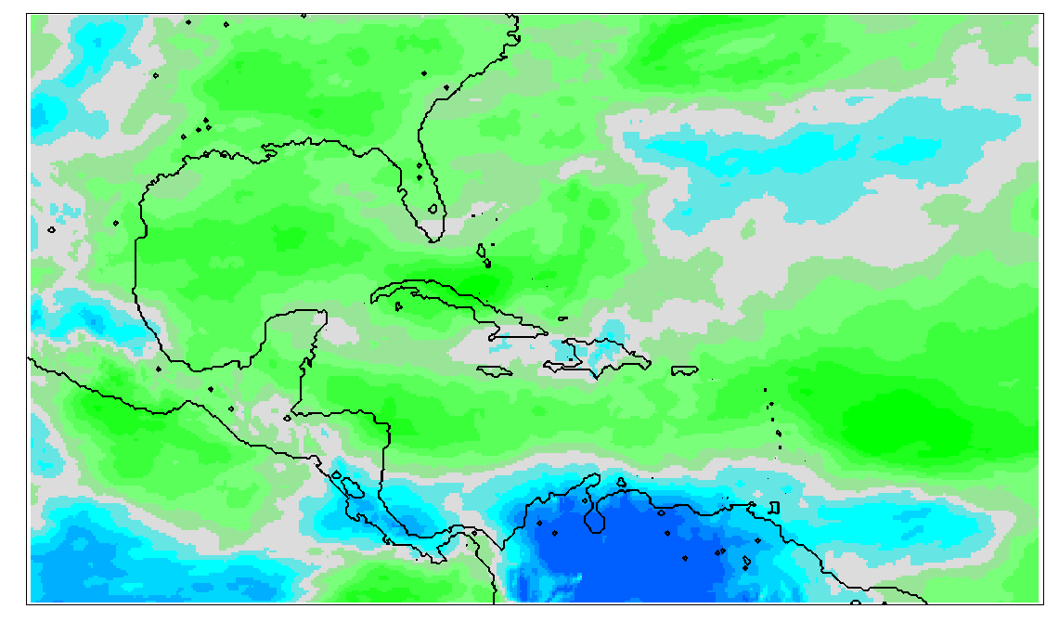
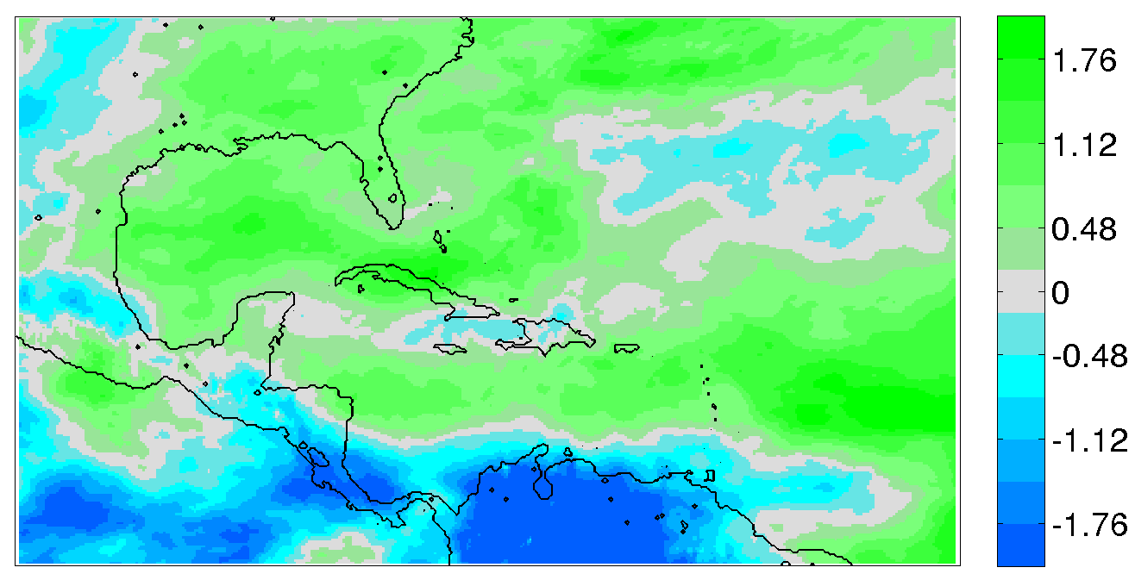
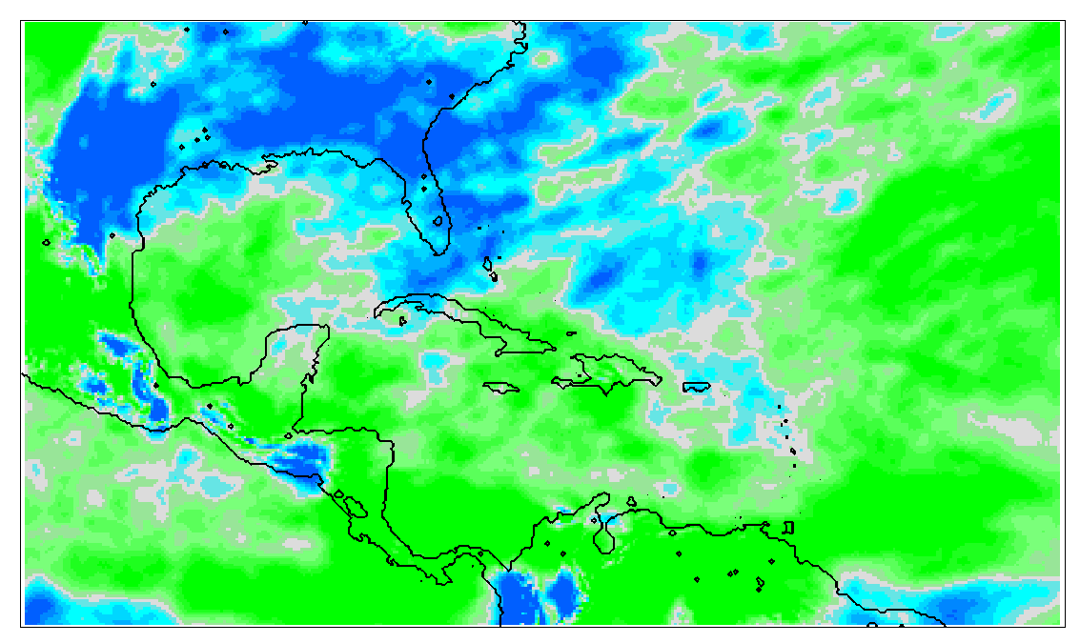
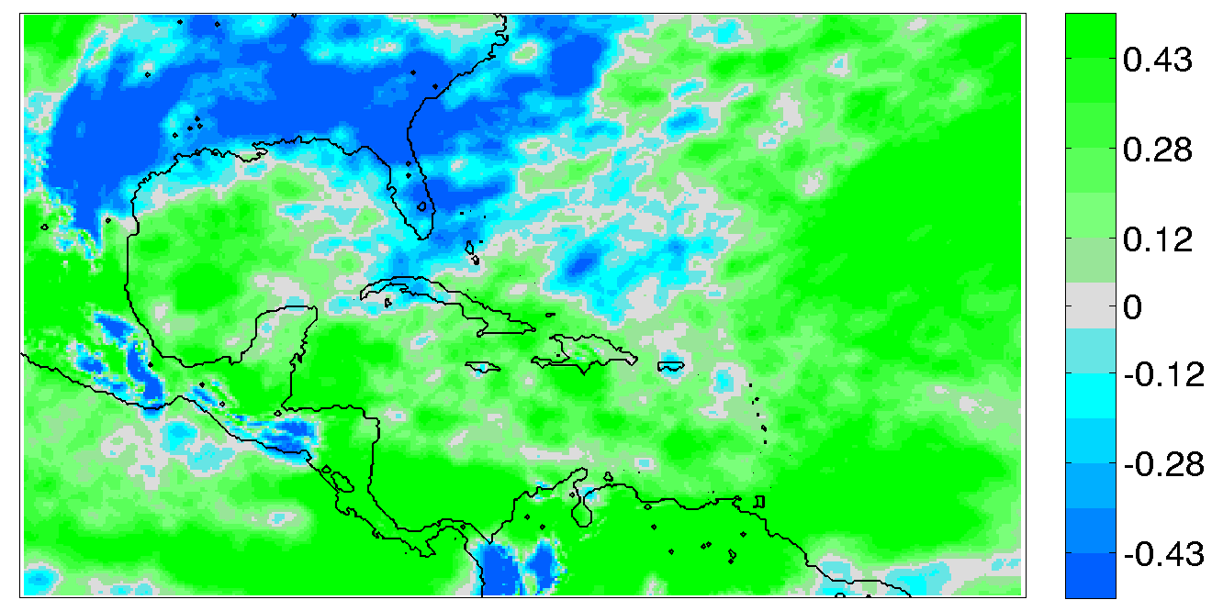
24-hr forecast verification against ERA-I
CTL02 – ERA-I
CTL10 – ERA-I
150 hPa Temperature
warmer
Less cool
cooler
500 hPa Zonal Wind
More westerly
700 hPa Specific Humidity

Slide 9
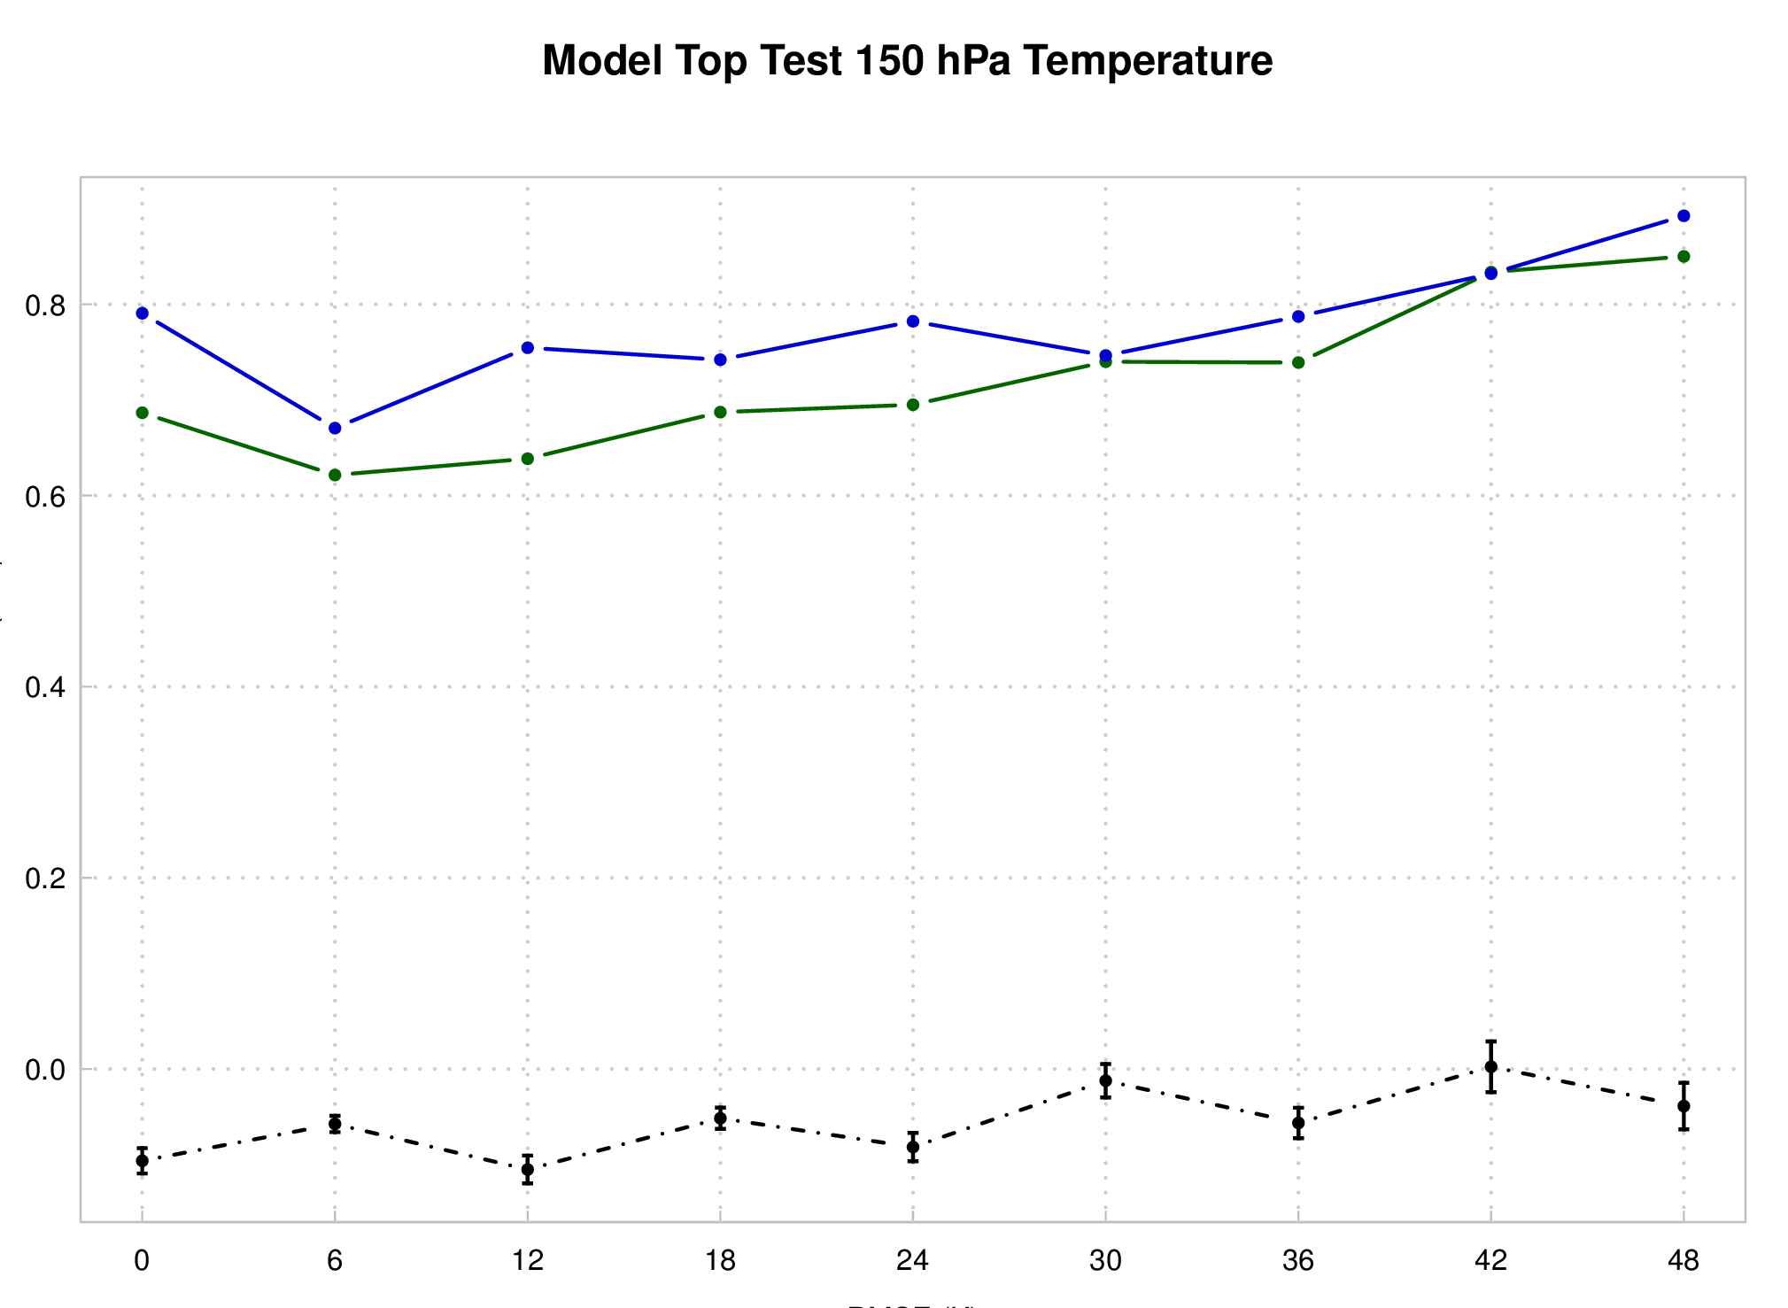
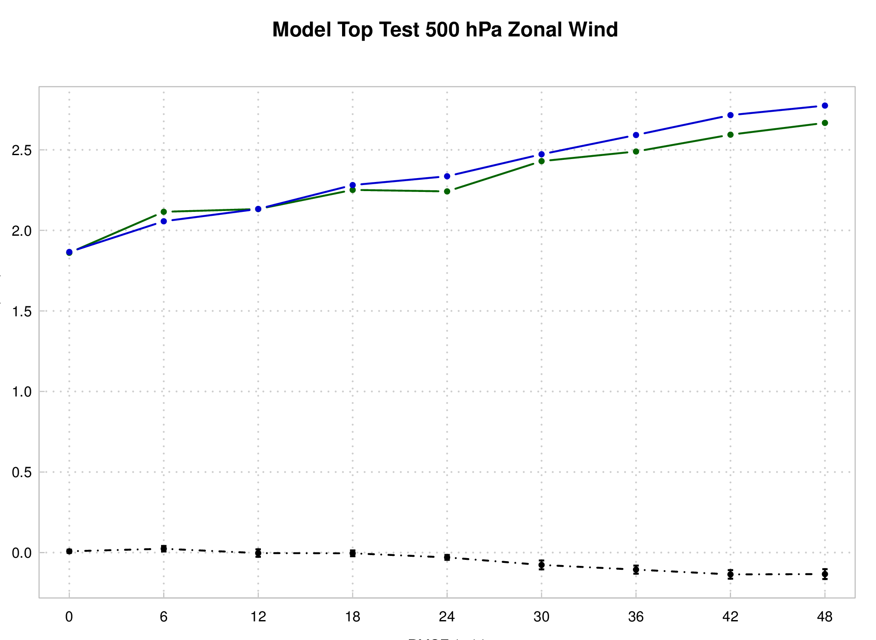
Model top test: verification against ERA-I
RMSE
150 hPa T
500 hPa U
CTL02 CTL10 CTL02-CTL10 (pairwise)
Improvements consistent out to 30 hrs for Temperature
Zonal wind field SS improvement for longer leads: 24-48 hr

Slide 10
Ozone analysis tests
SBUV vs. CTL
GOME vs. CTL

Slide 11
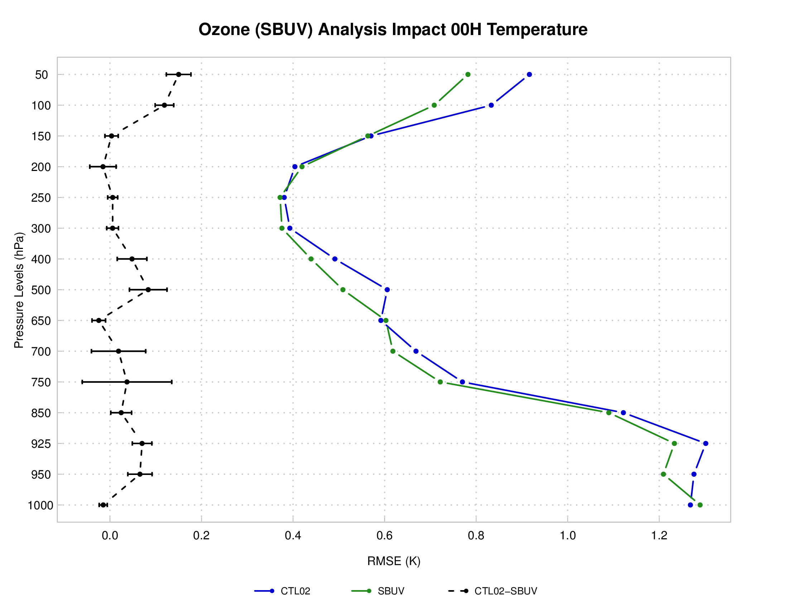
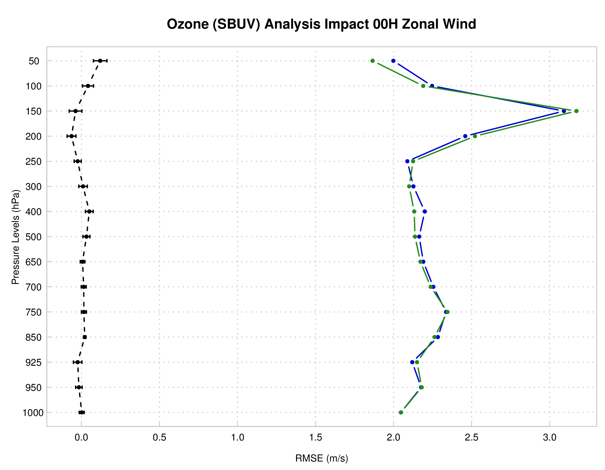
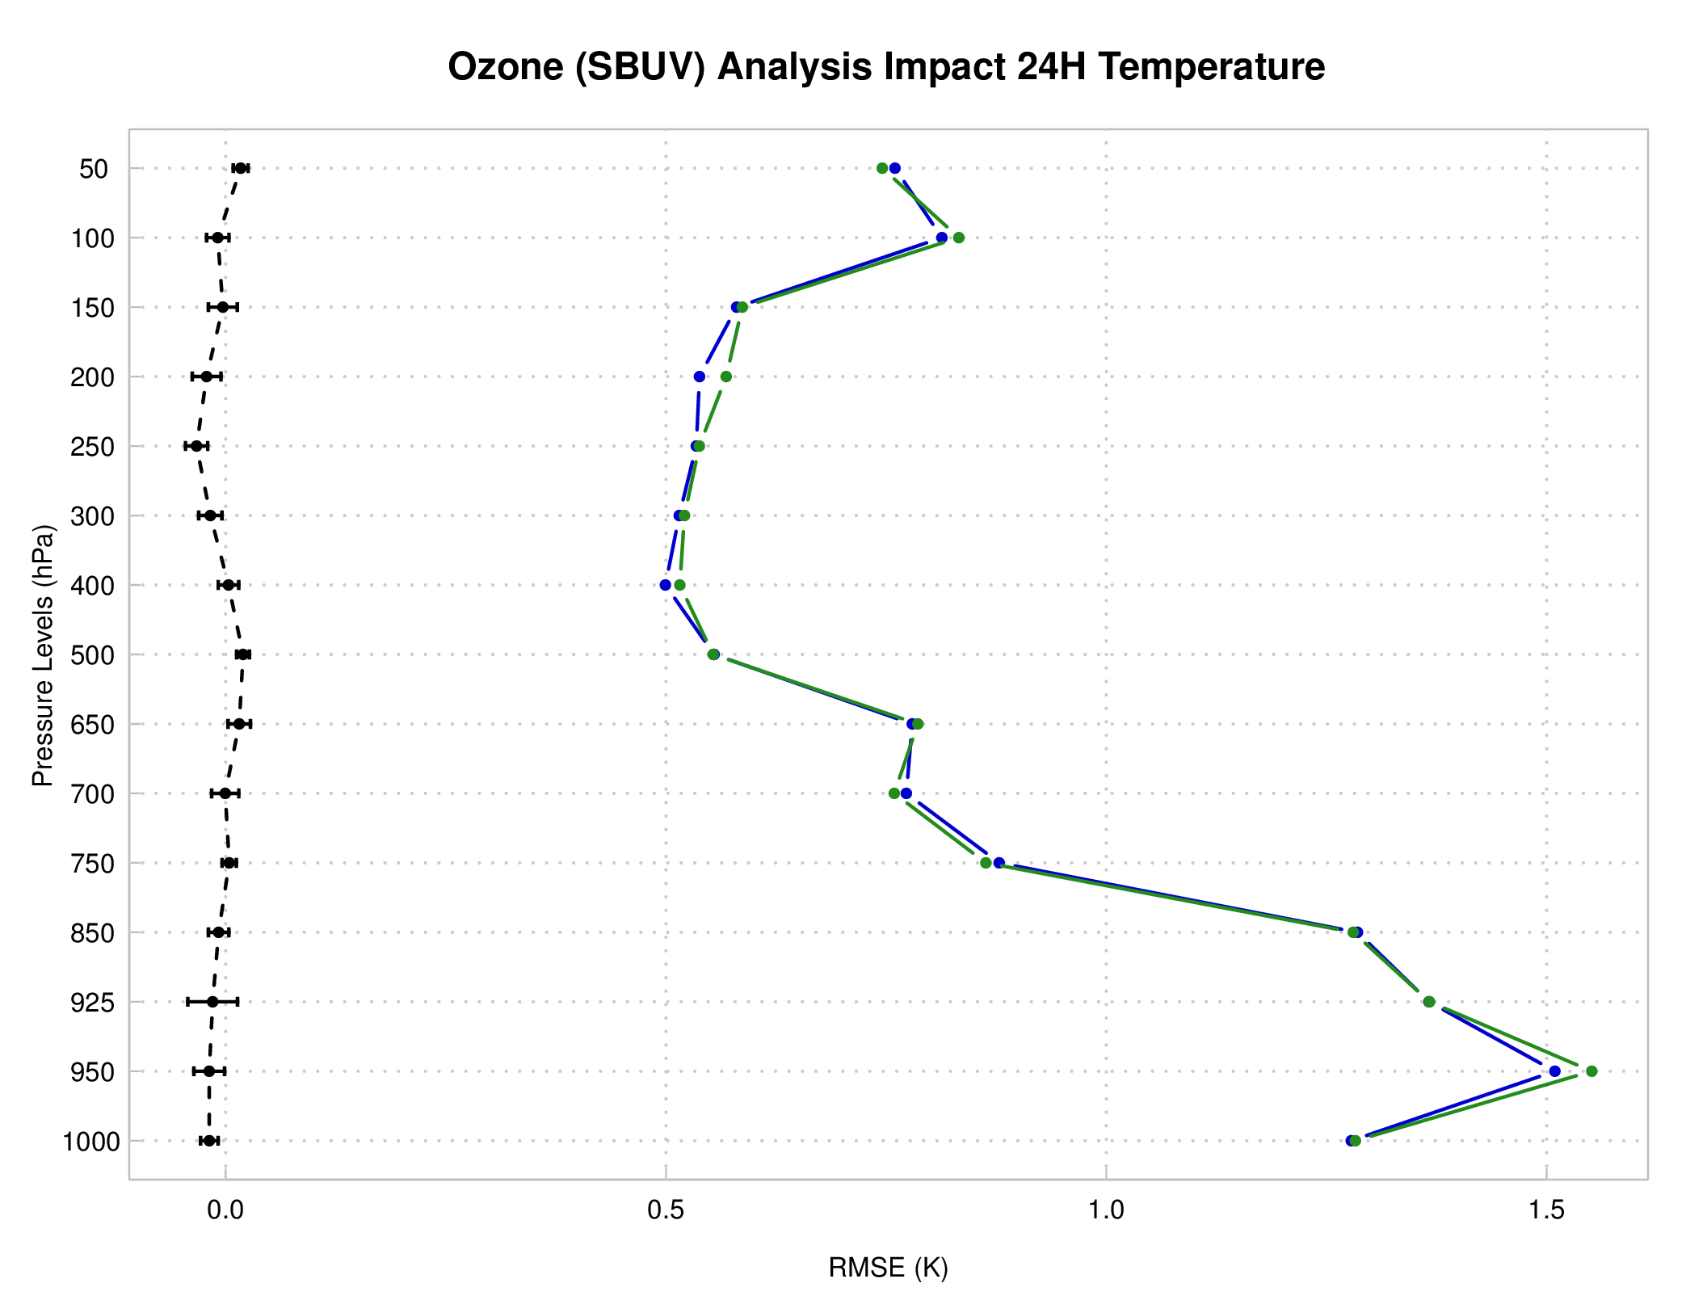
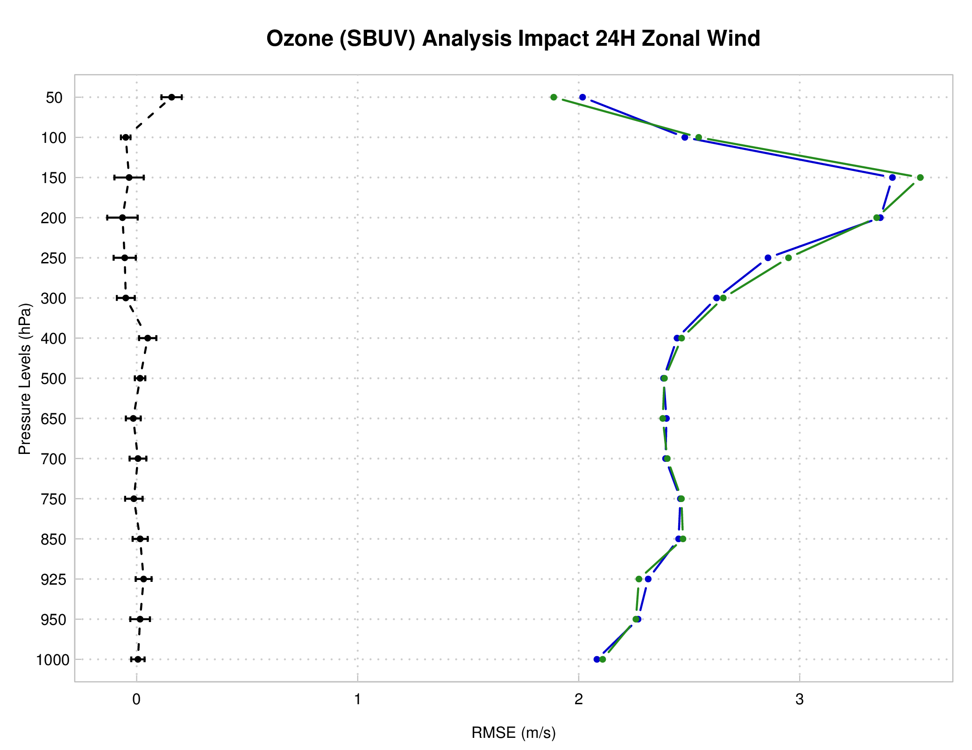
SBUV: verification against ERA-I
Analysis
Analysis:
  Strong signal for improved T field
  Small mixed improvements for U (V)
24 hr Forecast:
  Most SS differences washed out
  Ozone limited to analysis …
T
U
24-hr forecast
T
U
SBUV CTL02 CTL02-SBUV (pairwise)

Slide 12
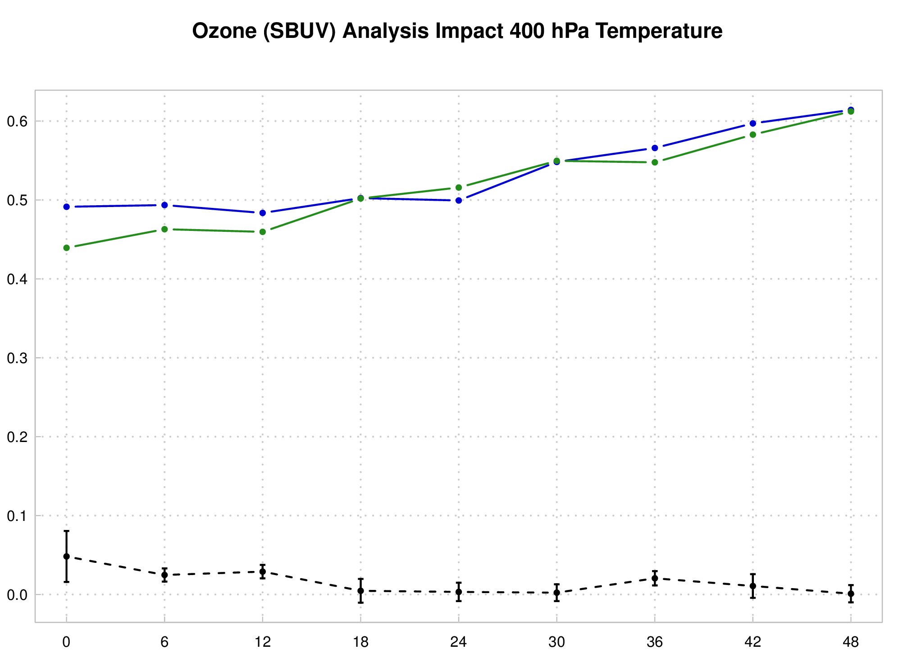
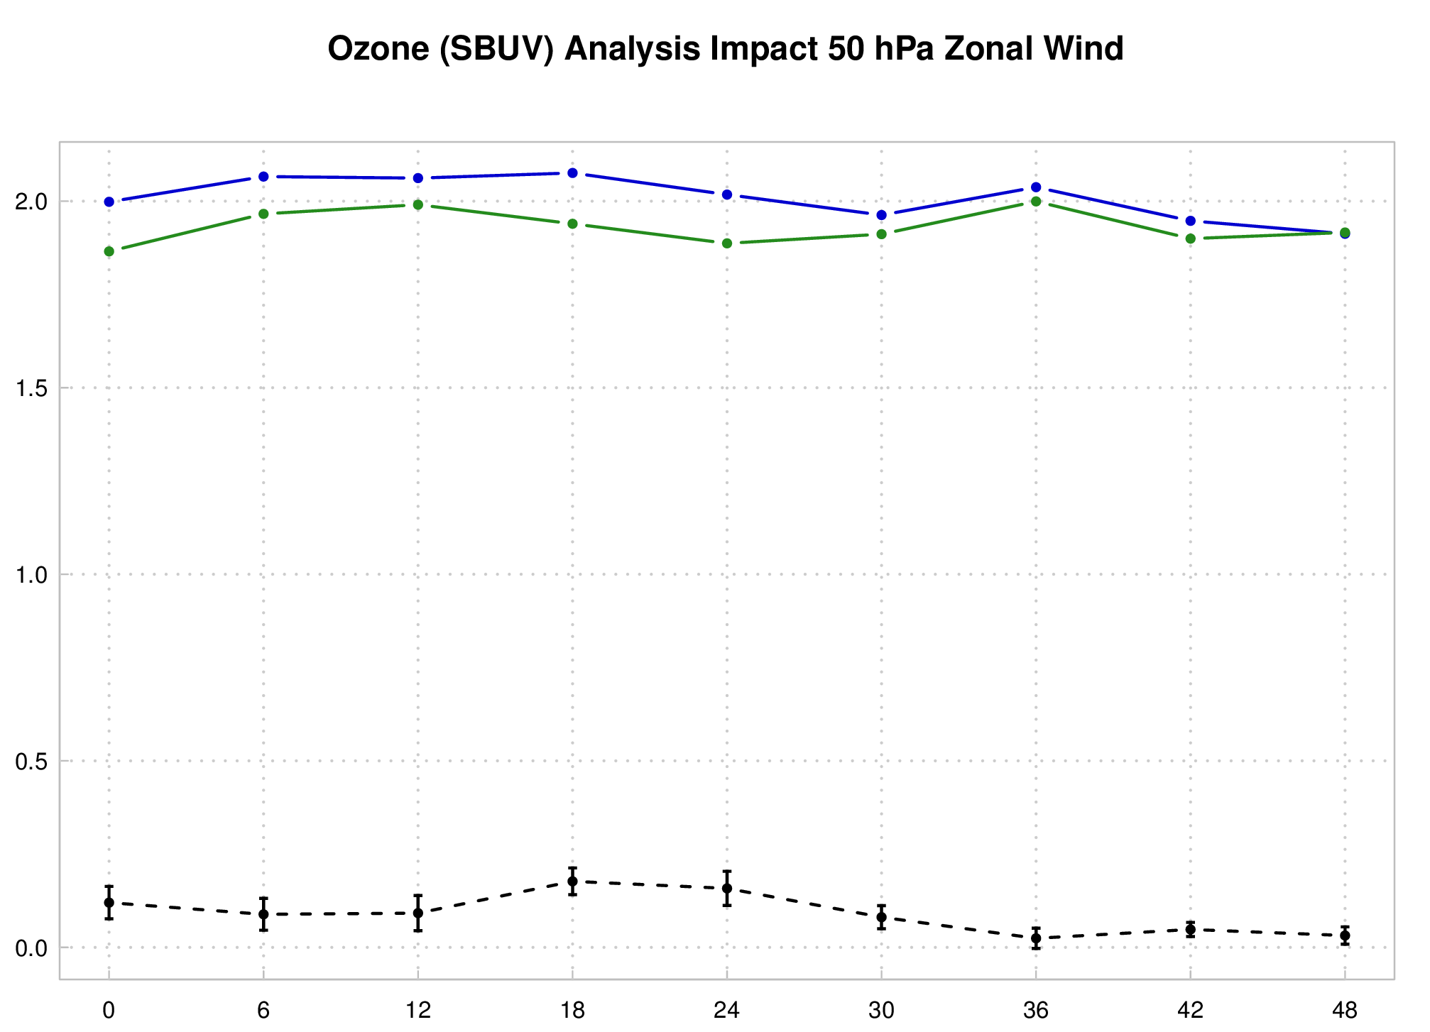
SBUV: verification against ERA-I
RMSE
400 hPa T
50 hPa U
SBUV CTL02 CTL02-SBUV
Select levels with SS improvements show consistent SS improvements
  T: Impact limited to ~18 hrs
  U: Impact present longer in forecast

Slide 13
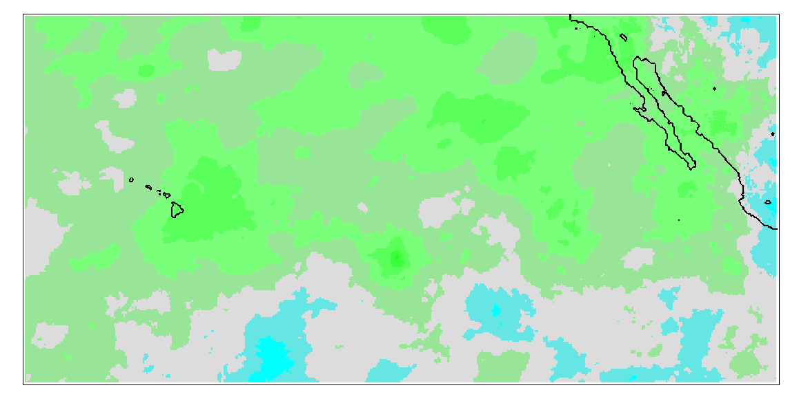
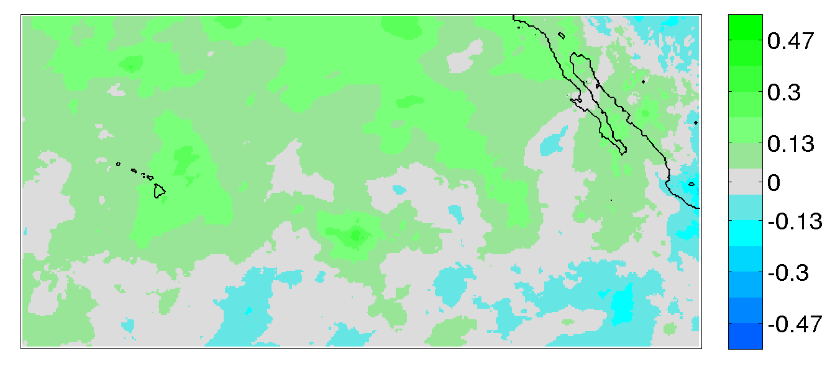
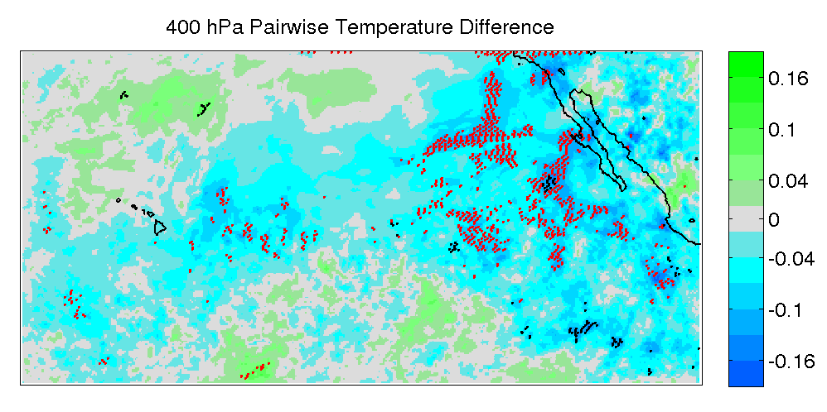
SBUV Ozone analysis: 12hr 400 hPa Temperature
CTL02-ERA
SBUV-ERA
warmer
Model runs against ERA: CTL too warm, SBUV impact cools (more consistent w/ ERA)
Pairwise SS for each grid point: SBUV cooling pattern SS

Slide 14
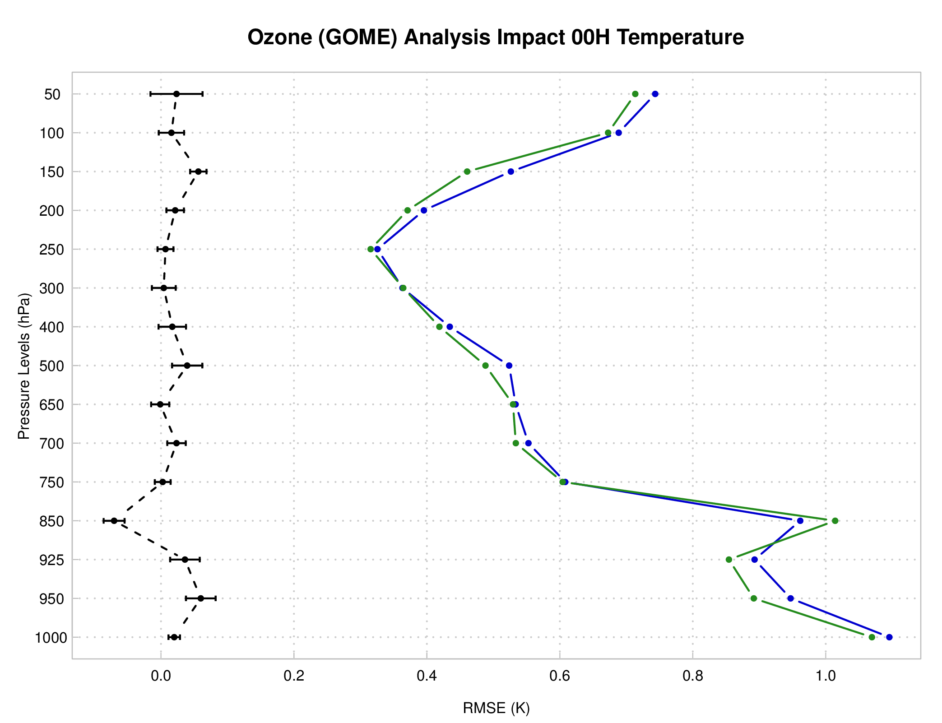
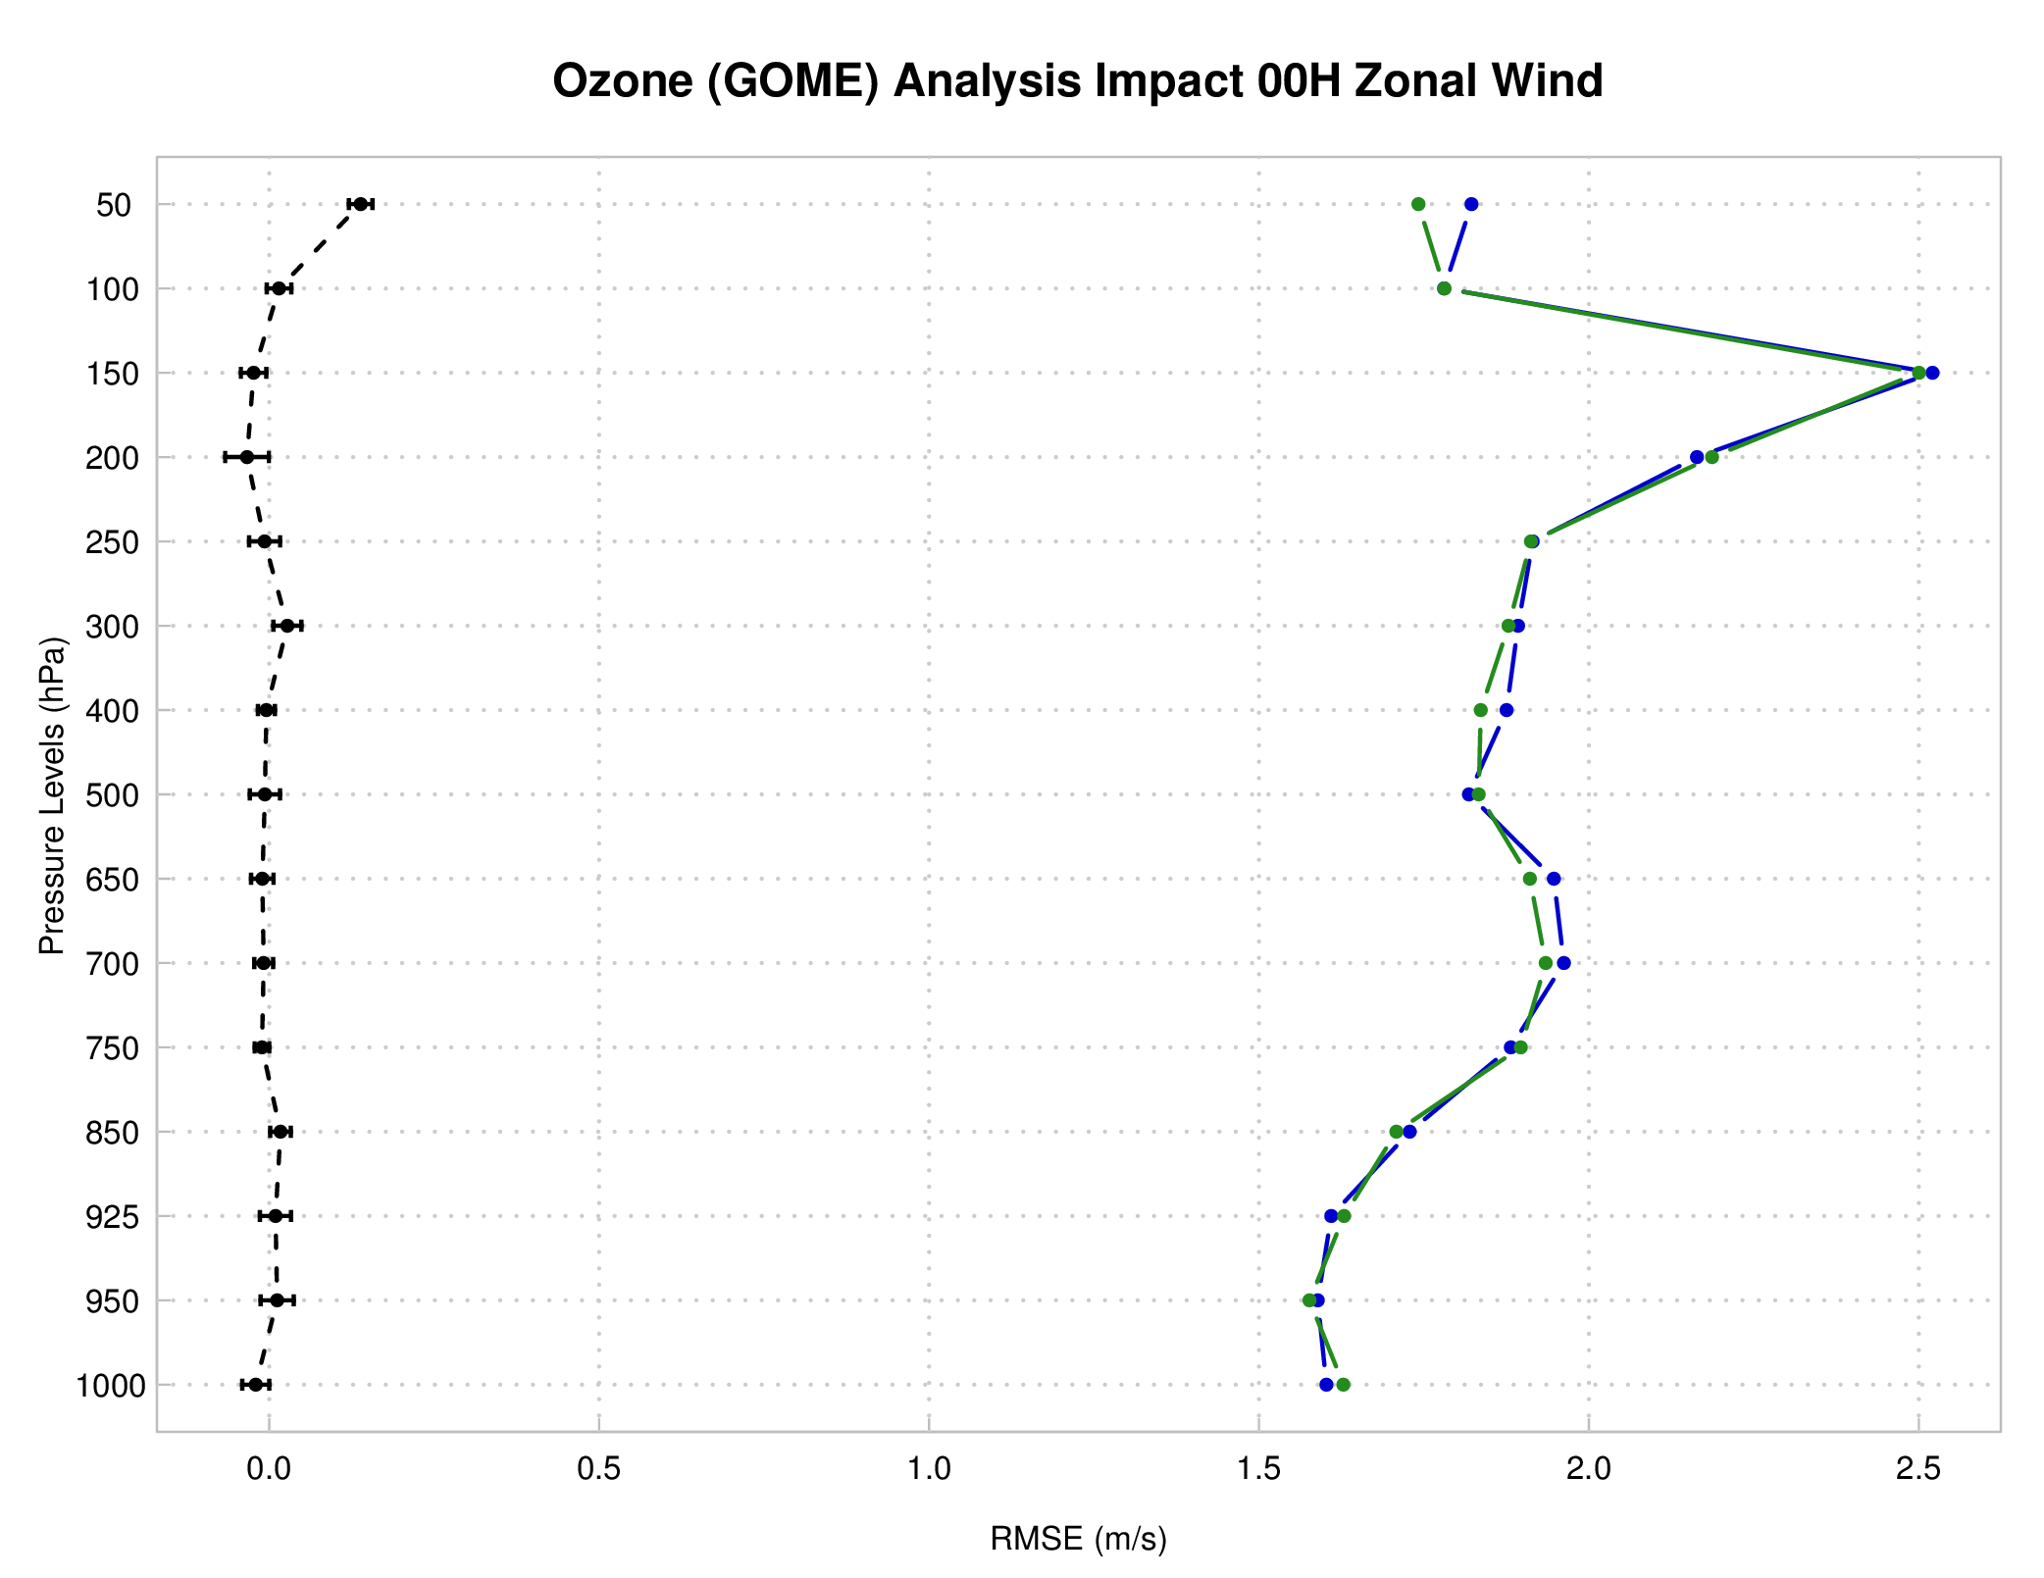
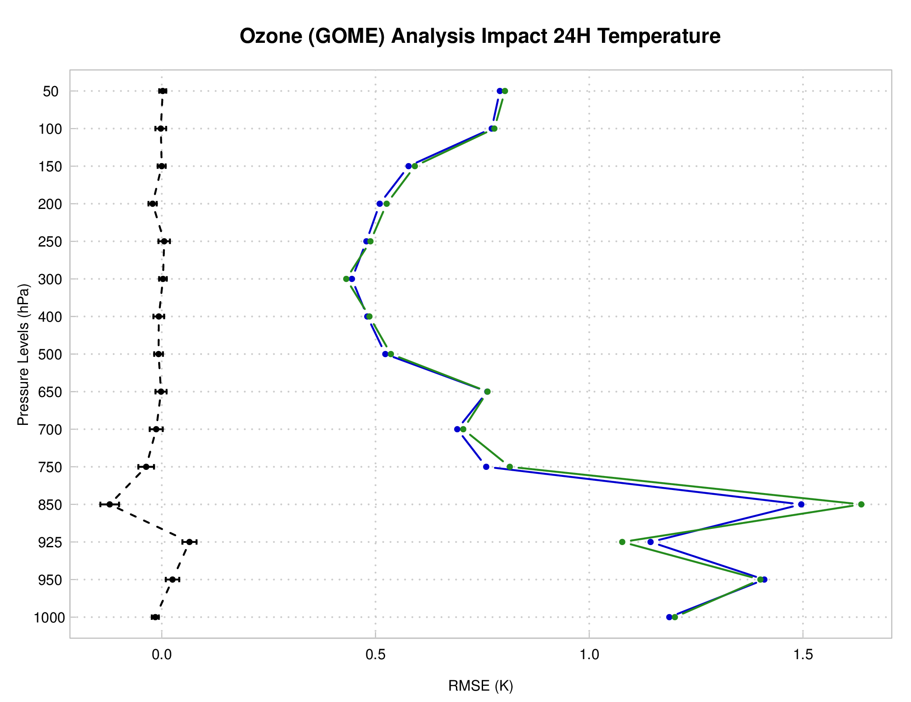
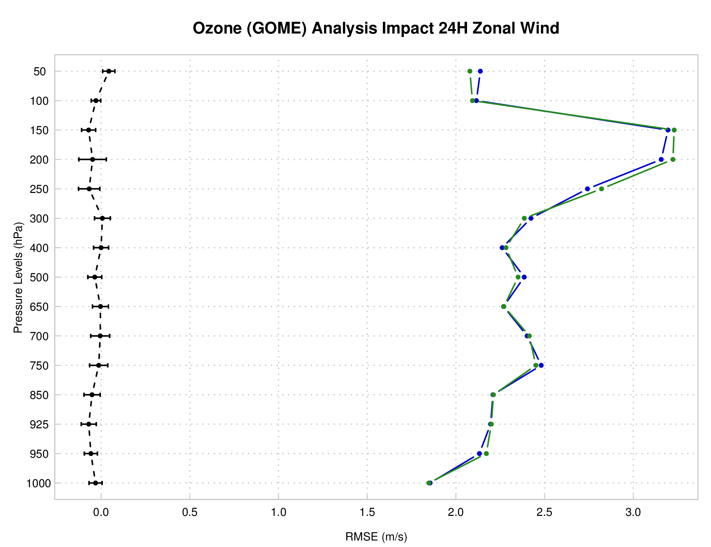
GOME: verification against ERA-I
Analysis
Analysis:
  Consistent T impact to GOME
  Neutral U (exp. 50 hPa SS)
24 hr Forecast:
  Consistent results to GOME, impact lost by 24 hrs
  Small SS degradation signal in 24-hr U
T
U
24-hr forecast
T
U
GOME CTL02 CTL02-GOME

Slide 15
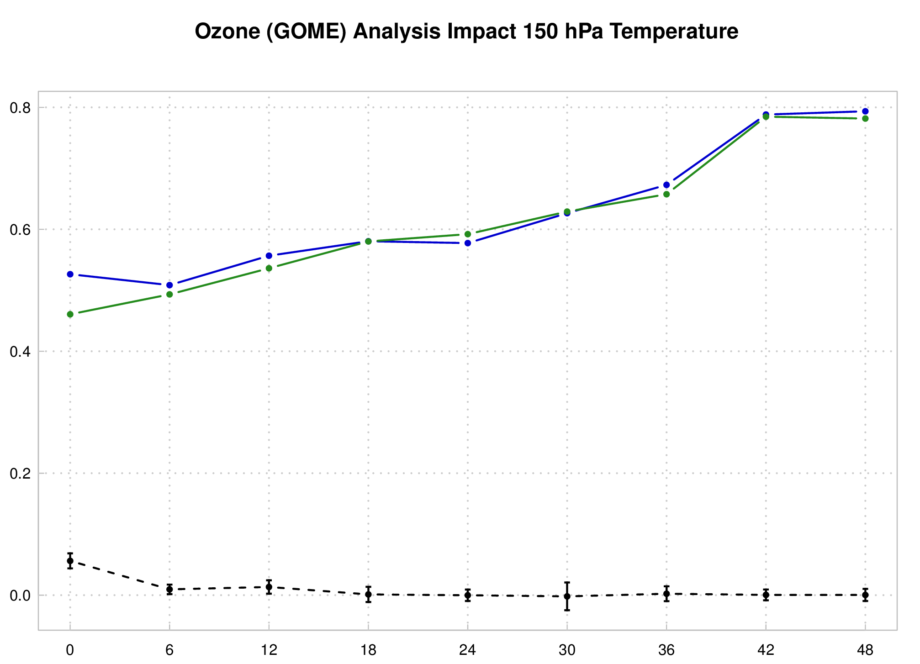
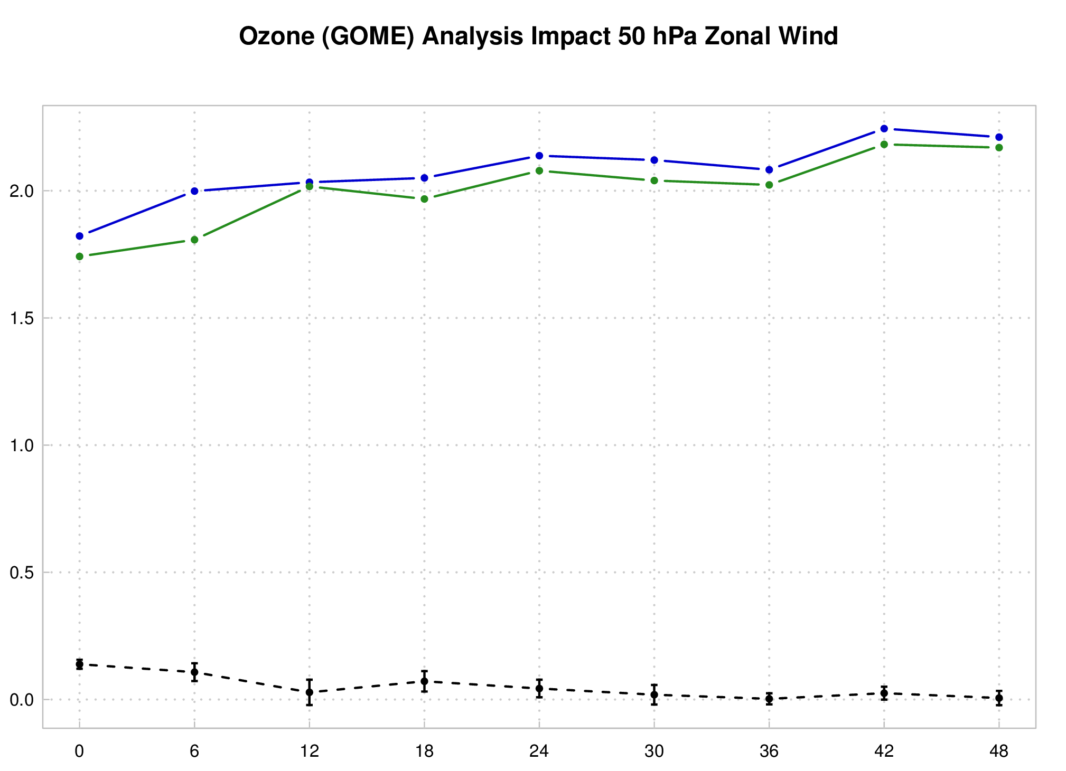
GOME: verification against ERA-I
RMSE
150 hPa T
50 hPa U
GOME CTL02 CTL02-GOME
T improvement diminishes by 18 hr
U RMSE reduction present for all forecast times, SS out to 18 hr

Slide 16
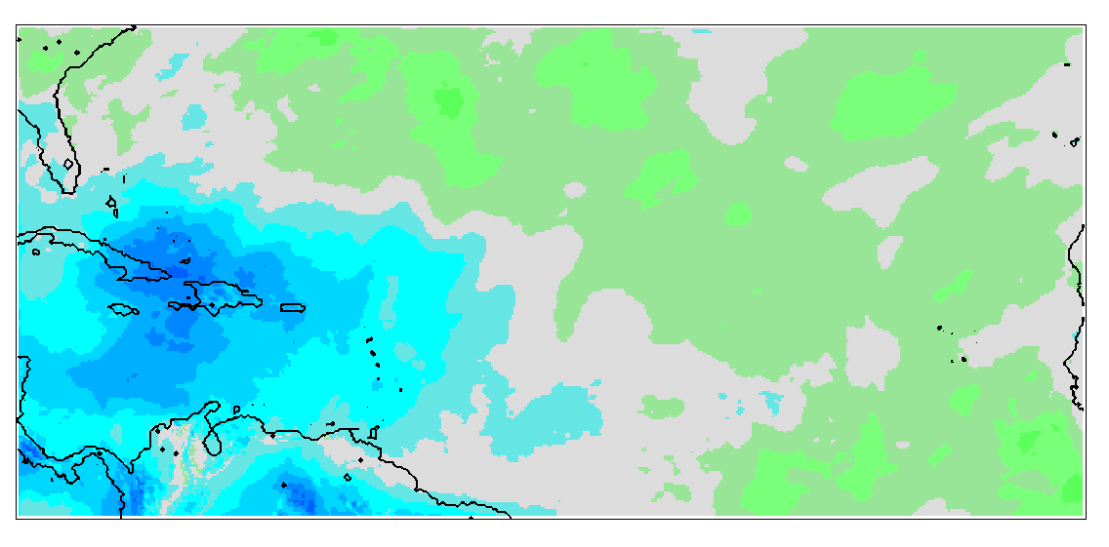
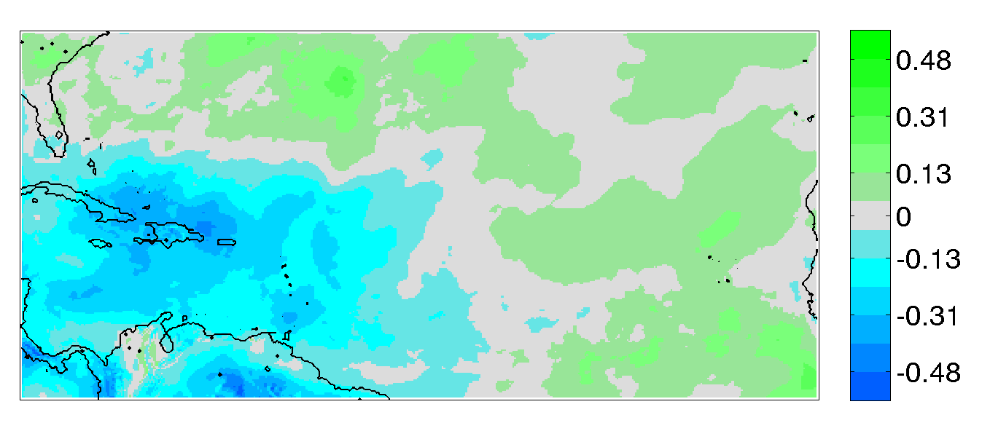
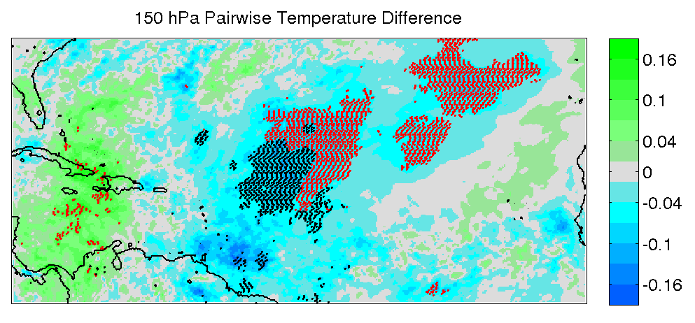
GOME Ozone analysis: 12hr 150 hPa Temperature
CTL02-ERA
GOME-ERA
warmer
Model runs against ERA: CTL too warm, GOME impact cools (more consistent w/ ERA)
Pairwise SS for each grid point: GOME cooling pattern SS

Slide 17
Summary
Model Top:
  Increasing model top from 10 hPa to 2 hPa resulted in improved T, U (V), with neutral SPFH
Ozone Analysis:
  SBUV and GOME ozone were assimilated into GSI using GFS ozone for background
    Only analysis update, indirect impact on radiances
  SBUV and GOME runs resulted in consistent (generally positive) changes over the control (CTL02)
    Improved T analysis with minor U (V) improvements
    Temperature and wind benefits present for short term forecast (~18 hrs)
    Temperature improvements suggest ozone analysis run cooler (& more consistent with ERA-I) than control
    Overall, SBUV showed more positive impact than GOME

