Slide 1

Indirect impact of ozone assimilation using Gridpoint Statistical Interpolation (GSI) data assimilation system for regional applications
Kathryn Newman^{1,2}, Ming Hu^{1,3}, Hui Shao^{1,2} and
Christopher Williams^{1,2}
¹ Developmental Testbed Center (DTC)
² National Center for Atmospheric Research (NCAR)/Research Applications Laboratory (RAL)
³ National Oceanic and Atmospheric Administration (NOAA)/Global Systems Division (GSD)
Acknowledgement: US Air Force
16th Annual WRF User’s Workshop June 15-18, 2015 Boulder, CO

Slide 2
Overview and Motivation
Assess utility of SBUV profile ozone when assimilated into Gridpoint Statistical Interpolation (GSI) for regional applications without prognostic ozone
  Evaluate forecast performance for regional scale model forecasts (ARW)
Determine forecast impact from increasing model top from 10 hPa to 2hPa
  Necessary for ozone assimilation
Explore use of ozone data in GSI/ARW
  Does this data provide impact without being propagated into model variables?

Slide 3
Experiment Design
GSI v3.3 (3d-var) coupled with WRF-ARW v3.6.1
  Partial cycling scheme – cold start 06/18, warm start 12/00
Testing period: 2014 August 1-31
15 km horizontal resolution, 62 (57) vertical levels, 2 mb (10 mb) model top
48-hr deterministic forecasts initialized at 00/12
Observations Assimilated
Conventional | Air Force conventional observations
 | GPS-RO
Satellite Radiances | AMSU-A (noaa-15,-18,-19, metop-a,-b, aqua) | MHS (noaa-18,-19, metop-a,-b)
 | ATMS (npp) | IASI (metop-a,-b)
 | HIRS4 (noaa-18,-19, metop-a,-b) | CrIS (npp)
 | AIRS (aqua)
Ozone | SBUV (noaa-19)*
Atlantic Domain – GOME
E. Pacific Domain – SBUV

Slide 4
Model Top Test
Experiments:
CTL10: control
  Air Force operational configuration, except RRTMG used rather than RRTM/Dudhia
  57 vertical sigma levels
  10 hPa model top
CTL02:
  Stratospheric lapse rate applied
  62 vertical levels
  2 hPa model top
Verification against ERA-Interim reanalysis using Model Evaluation Tools (MET)
Notes:
48-hr deterministic forecasts initialized at 00/12
Verification aggregated over only 00 (12) UTC for SBUV (GOME) tests to isolate impact when data are present in domain.
15 km horizontal resolution

Slide 5
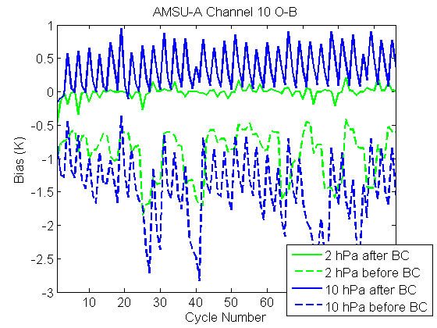
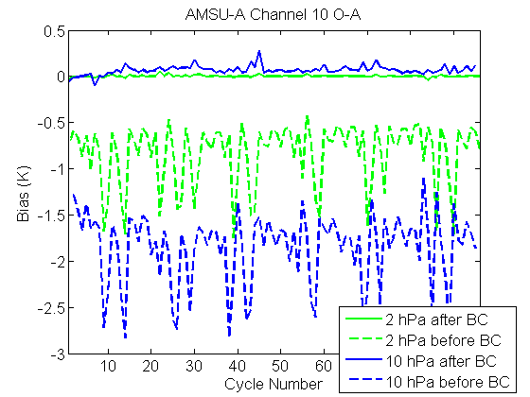
Model Top Test – GSI Diagnostics
Same channel selection for both configurations
2 hPa model top shows smaller bias

Slide 6
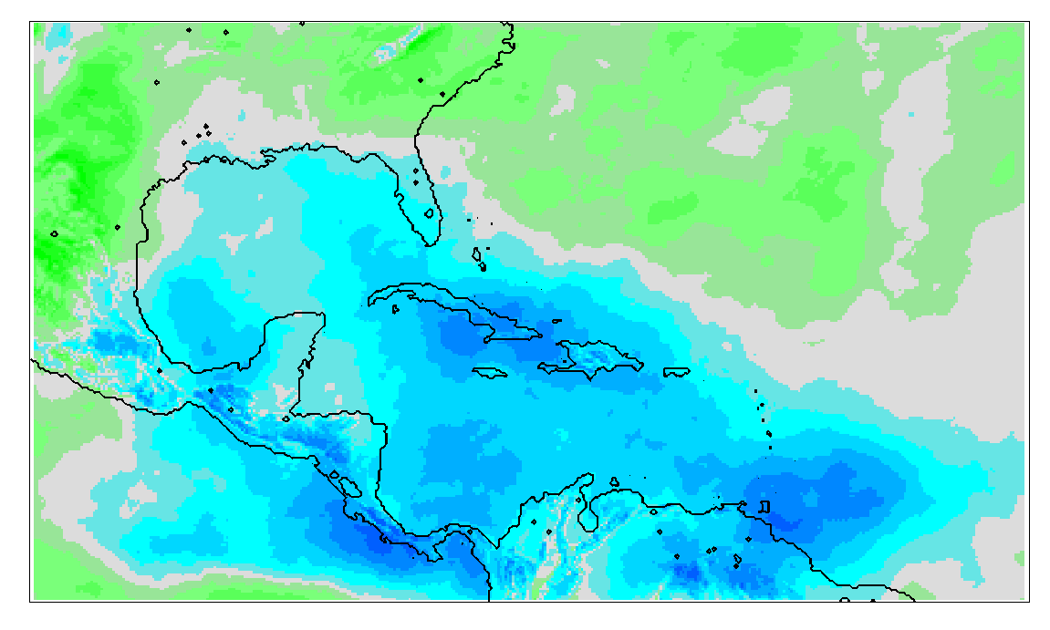
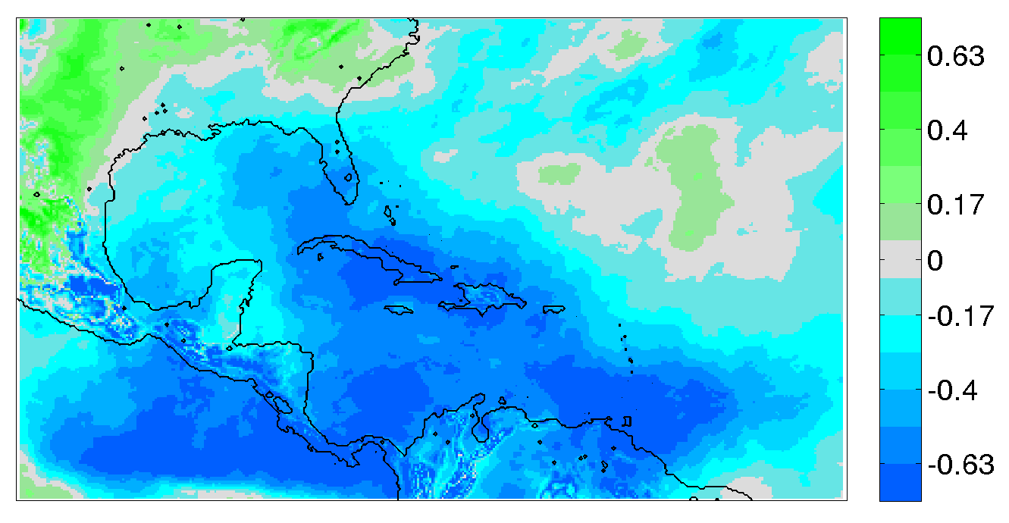
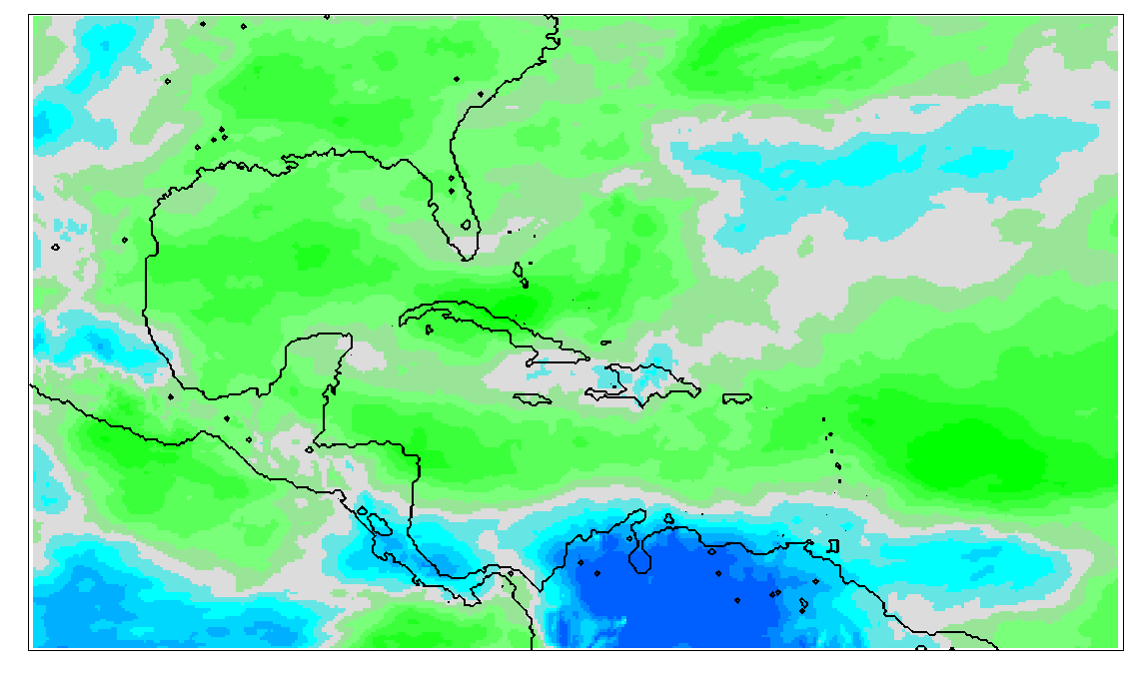
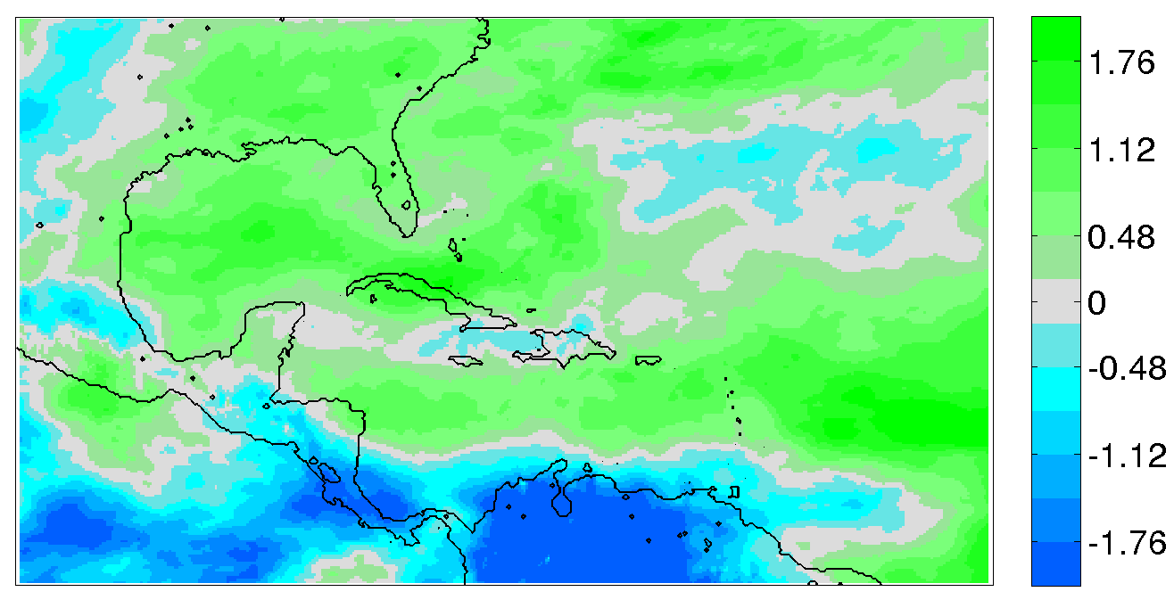
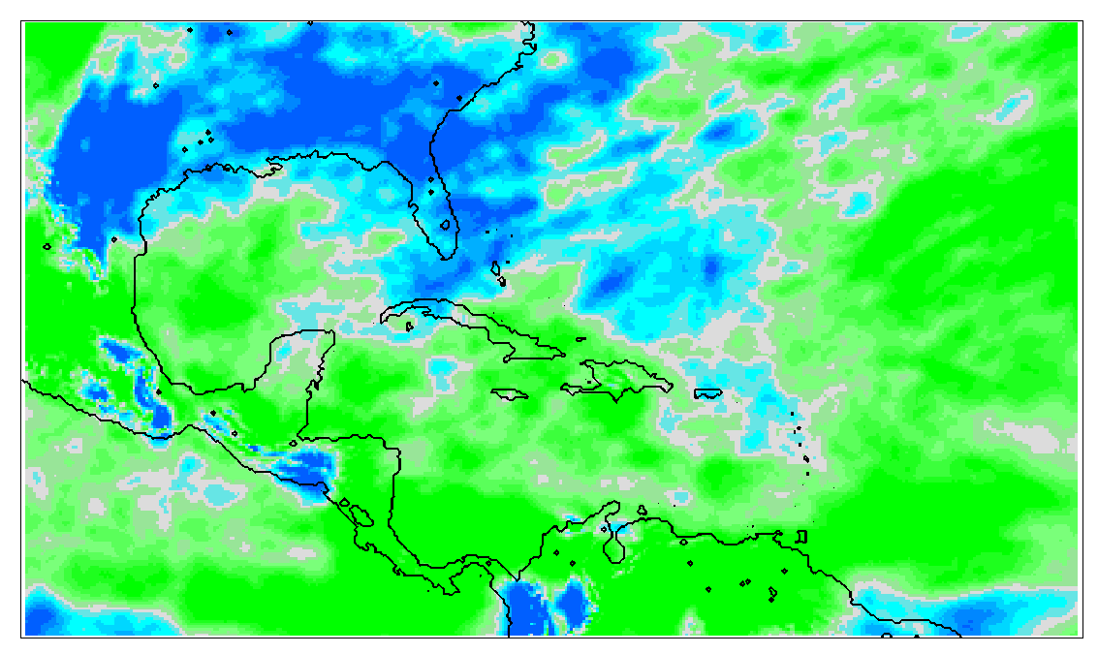
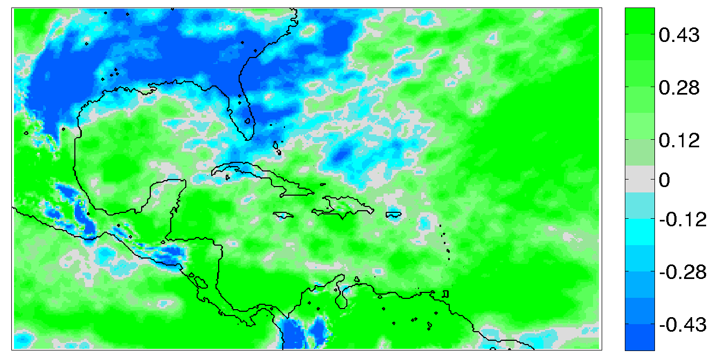
24-hr Forecast Verification (ERA-I)
CTL02 – ERA-I
CTL10 – ERA-I
150 hPa Temperature
warmer
Less cool
cooler
500 hPa Zonal Wind
More westerly
700 hPa Specific Humidity

Slide 7
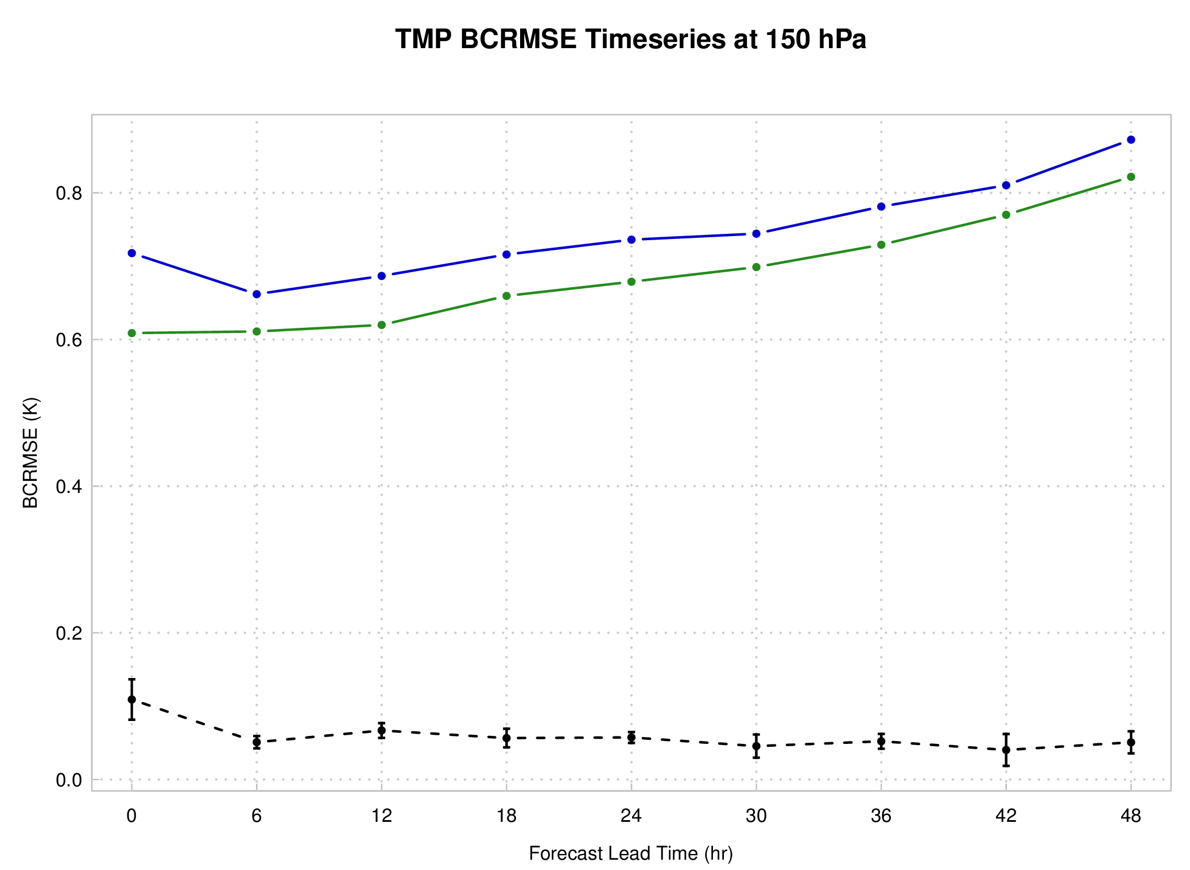
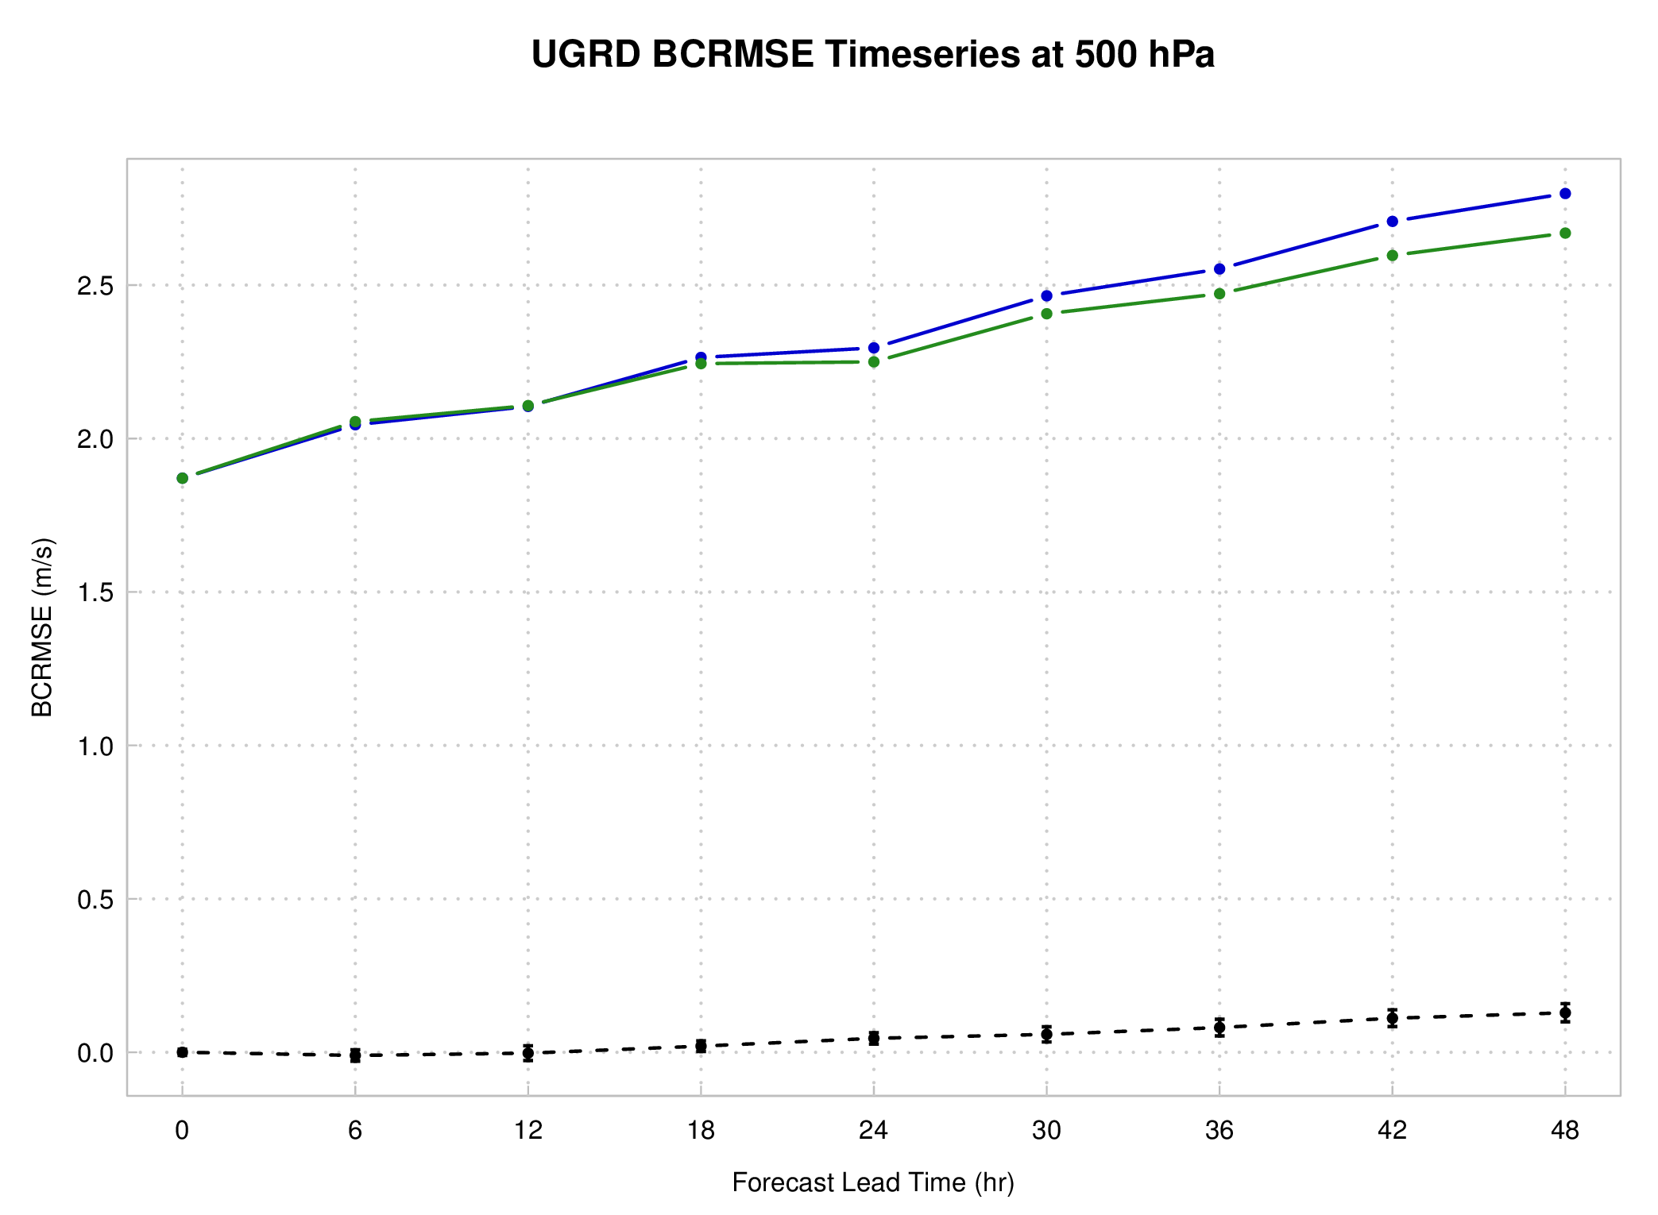
Model Top Test: Verification (ERA-I)
Bias Corrected RMSE
150 hPa T
500 hPa U
CTL02 CTL10 CTL02-CTL10 (pairwise)
Consistent statistically significant (SS) improvements for CTL02 in temperature for all lead times
Zonal wind field SS improvement for CTL02 for longer leads: 24-48 hr

Slide 8
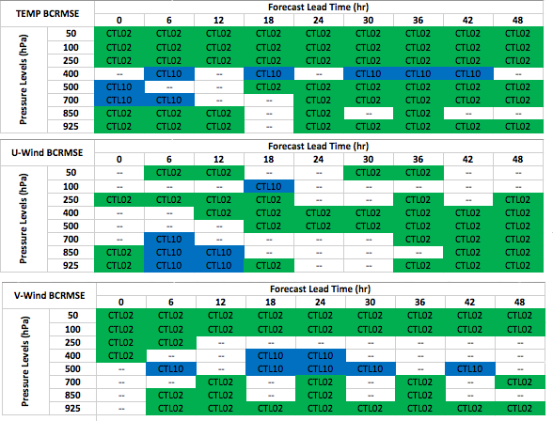
Model Top Test: Verification (ERA-I)
Lead Time (0-48 hr)
99% CI Statistical Significance Table (BCRMSE): CTL02 vs. CTL10
Improvement from 2 hPa model top
Consistent improvement throughout T field
Strong signal of improvement for zonal & meridional wind fields.
  U: longer lead times
  V: upper levels
Mixed results for specific humidity (not shown)
Model Levels
Statistically Significant (SS) pairwise differences (99%):
  Green shading: 2 hPa model top better Blue shading: 10 hPa model top better

Slide 9
SBUV: Experiment Design
SBUV Experiment Domain
Testing period: 1-31 August 2014
48-h deterministic forecasts initialized at 00/12
Experiments:
  CTL: Same configuration as in CTL02, including standard conventional and radiance data assimilated
  SBUV: with additional assimilation of Solar Backscatter Ultraviolet (SBUV/2; v8) profile ozone
    NOAA 19
Verification against ERA-Interim (ERA-I) reanalysis using Model Evaluation Tools (MET) and comparison to radiance observations.
O₃ not prognostic variable in ARW
  GFS ozone used for background
  Indirect impact on analysis and forecasts

Slide 10
Forecast Verification Against ERA-I
Verification against ERA-interim reanalysis

Slide 11
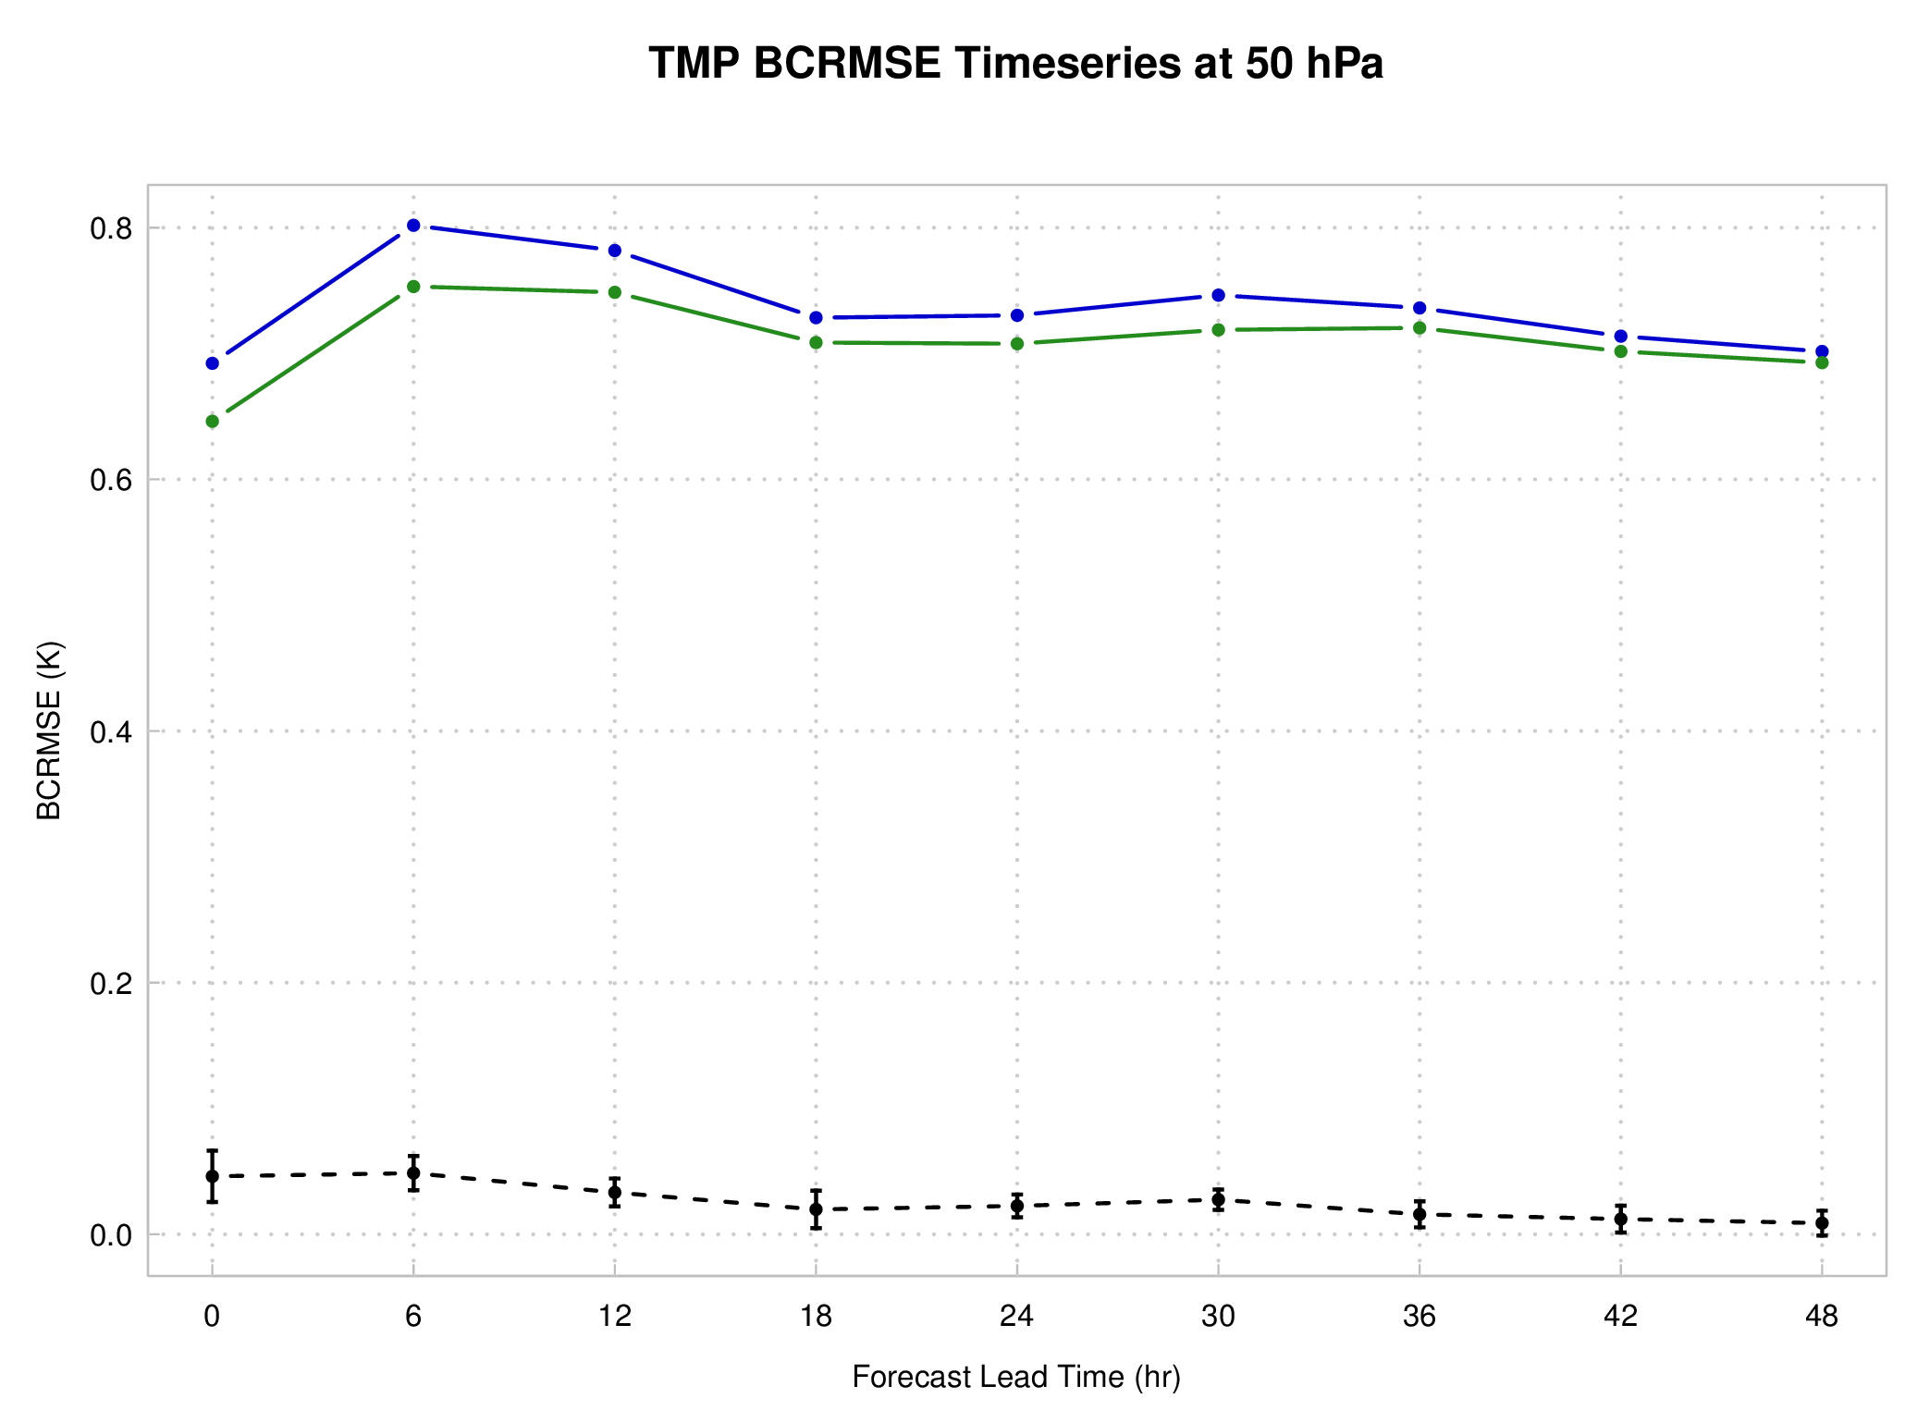
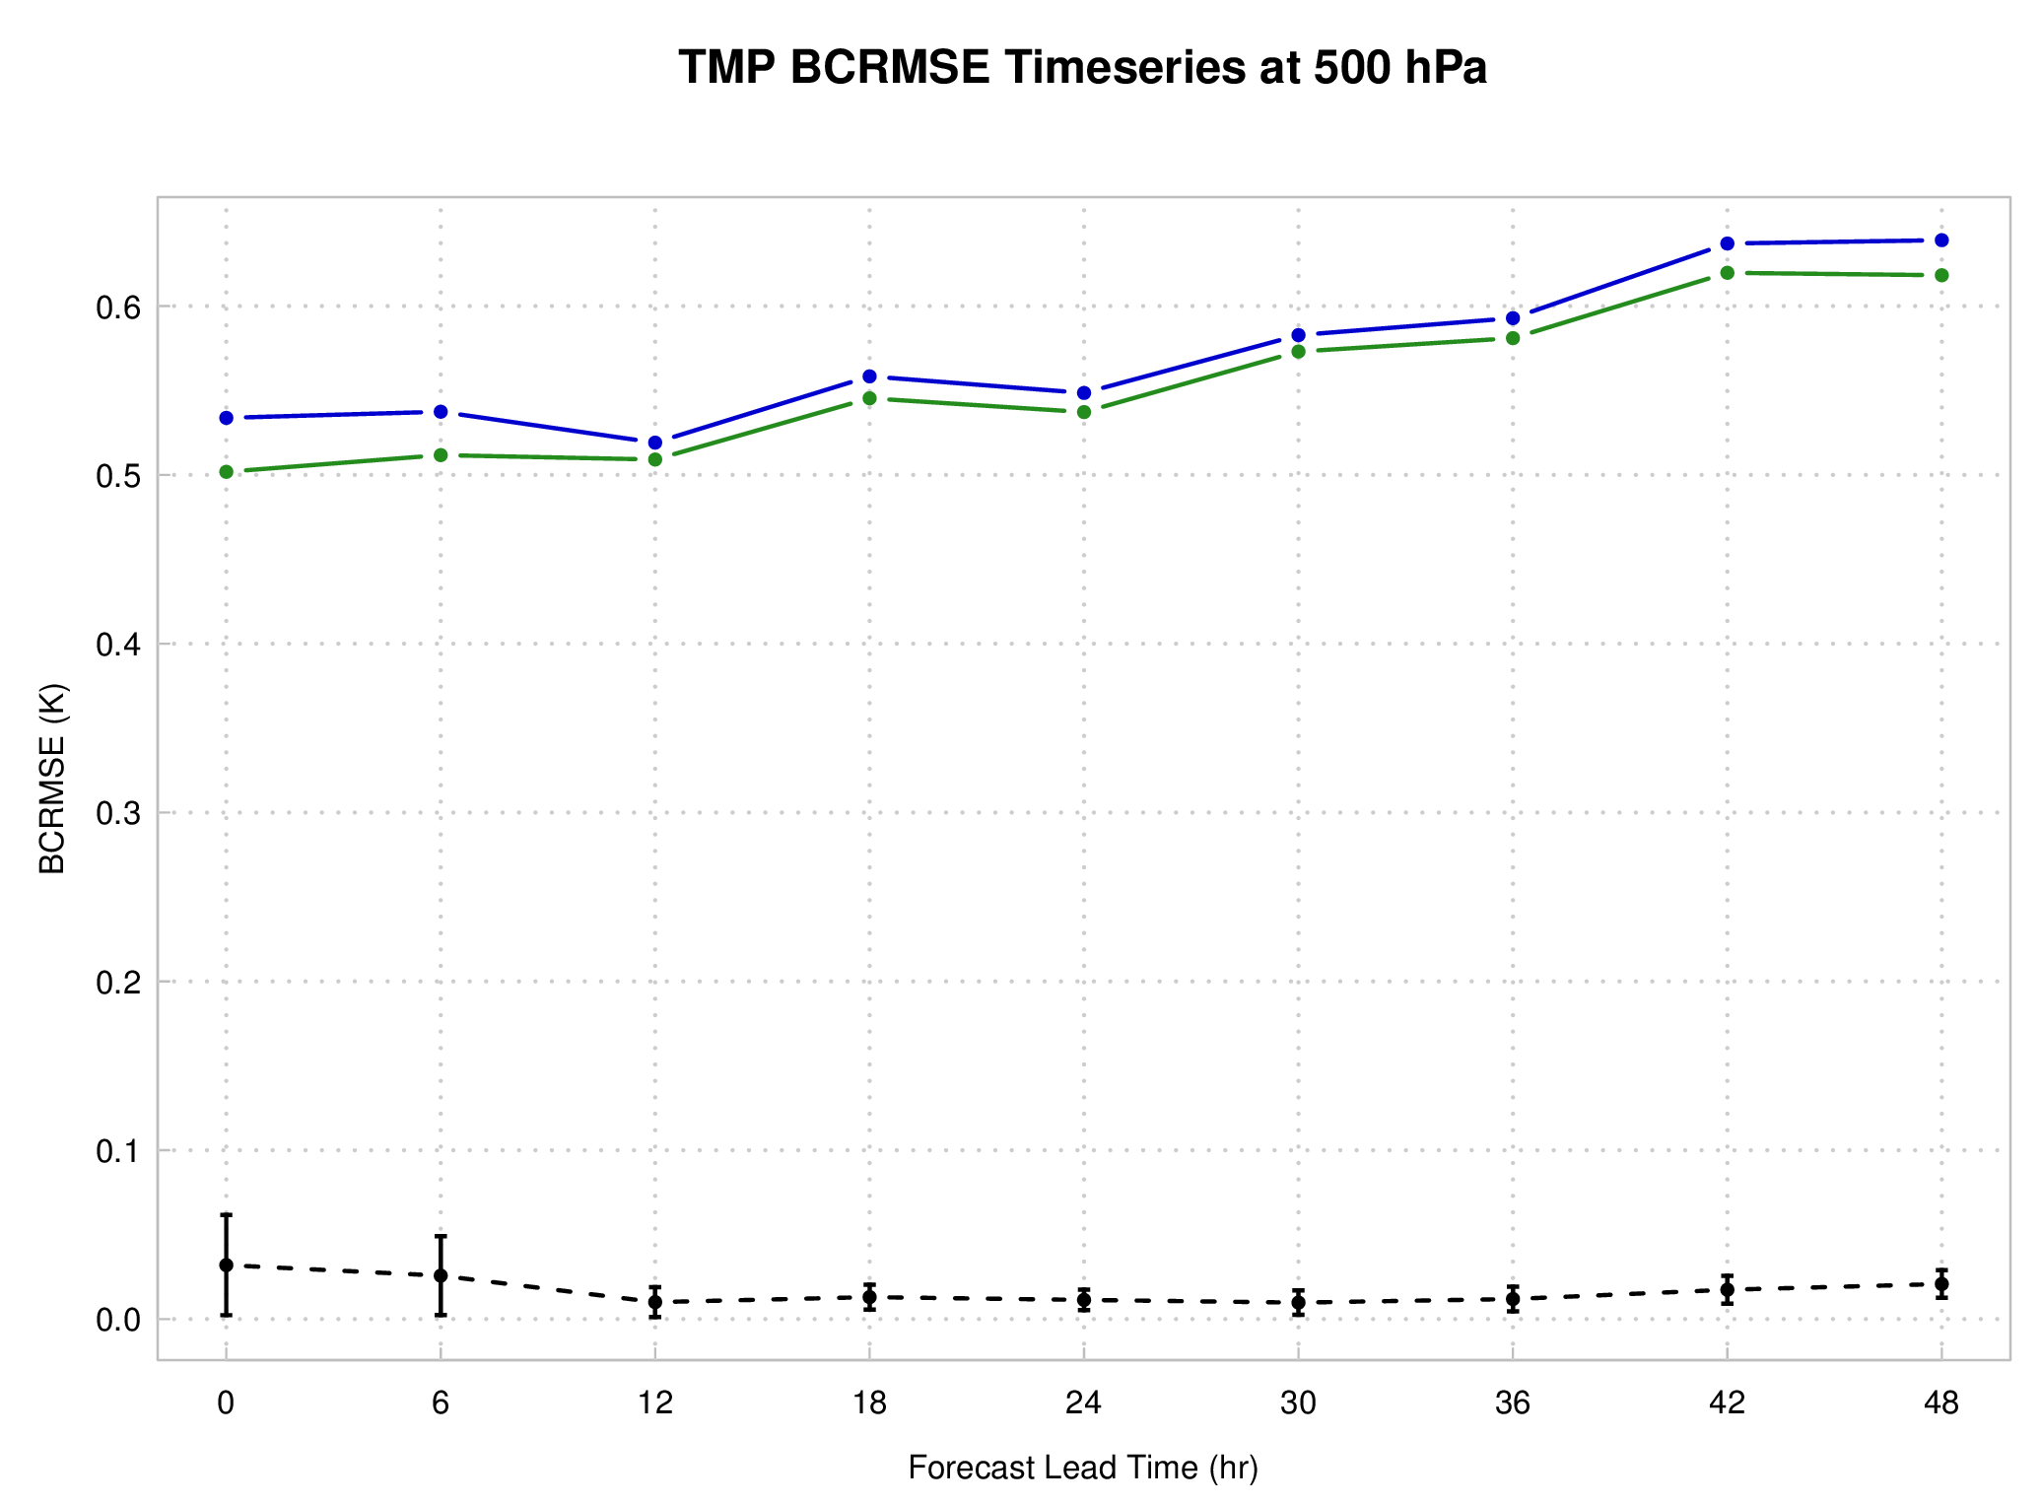
SBUV Impact: Verification (ERA-I)
CTL
SBUV
500 hPa T
50 hPa T
SS favoring SBUV
CTL-SBUV
  Bias Corrected RMSE of temperature forecasts at 50 hPa and 500 hPa
  Strongest improvement within first 24-hr forecast
  Small SS improvements present at longer leads at mid-level T

Slide 12
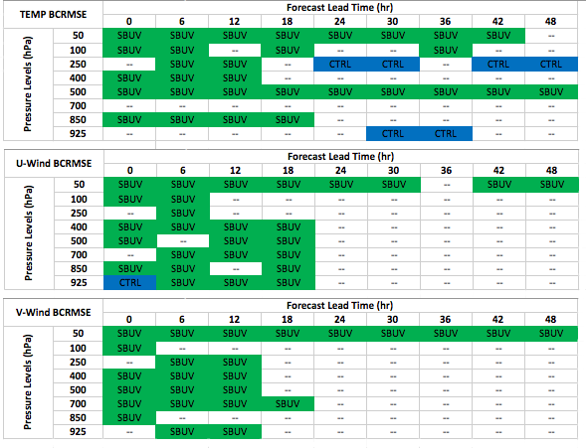
SBUV Impact: Verification (ERA-I)
99% CI Statistical Significance Table: SBUV vs. CTRL
Temperature:
  Positive impacts at upper- and mid-levels
  Degradation at 250 hPa after 24-hrs
Winds:
  Positive impacts particularly at early lead times
Mixed results for specific humidity (not shown)
  Green shading: SBUV better Blue shading: CTL better

Slide 13
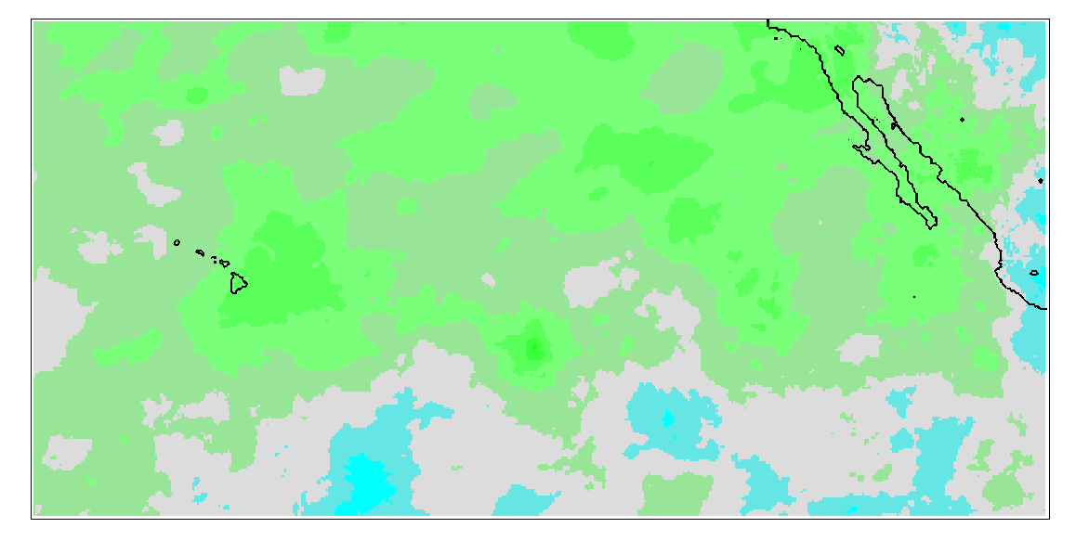
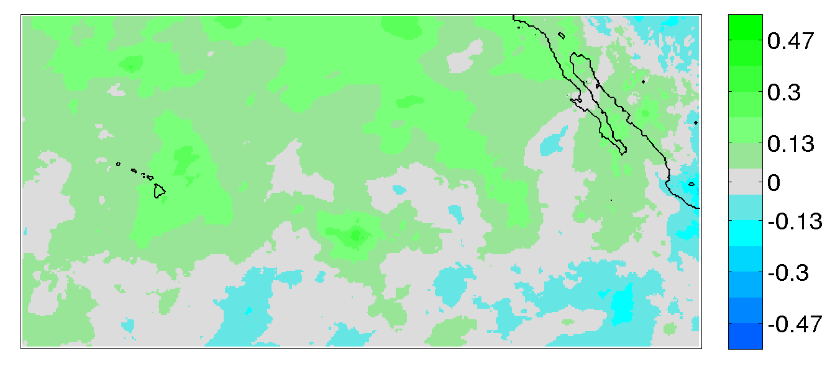
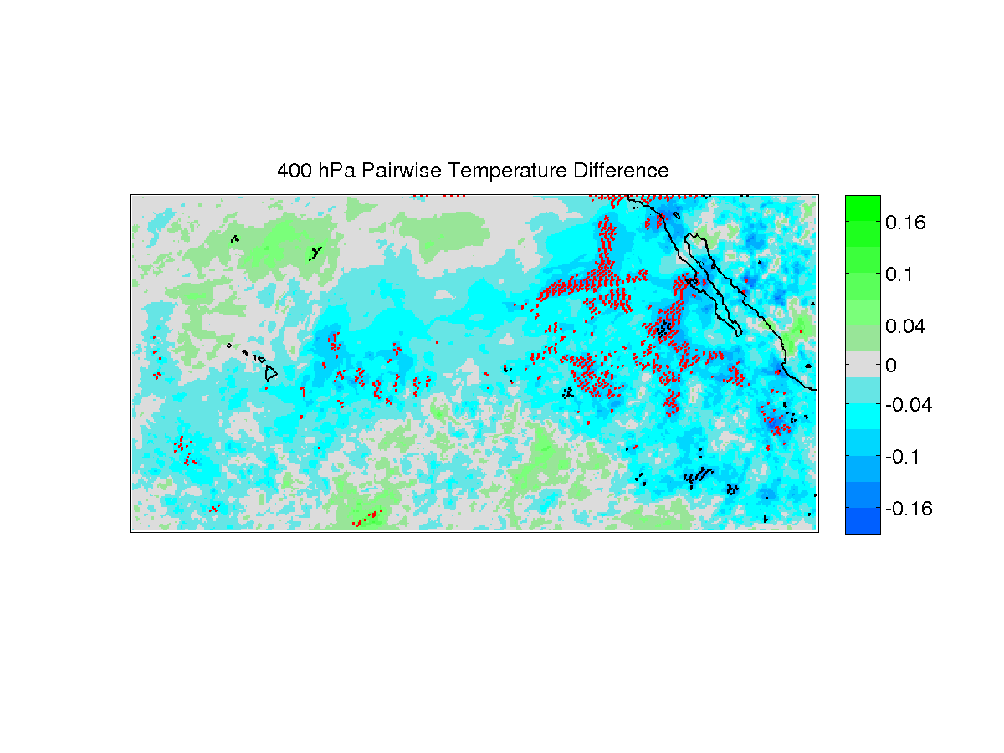
SBUV Ozone Forecast Impact
400 hPa Temperature: 12 hr forecast
CTL02-ERA
SBUV-ERA
warmer
  Lead time & level SS favoring SBUV
In general, cooling effects from SBUV assimilation
  More consistent w/ ERA-I
Spatially coherent SS differences favoring SBUV configuration
  Cooling trend for SBUV SS
Red points: pairwise SS positive impacts from SBUV

Slide 14
Forecast Verification Against Radiance Data
F-O against AMSU-A radiances
n19, n18 platforms chosen for coverage (n19 – largest coverage)
Channel 10: Higher peaking for model domain, temperature sensitivity
Channel 5: Mid-level weighting function peak, temperature sensitivity
Spatial verification averaged over 1 degree box, 1 month testing period

Slide 15
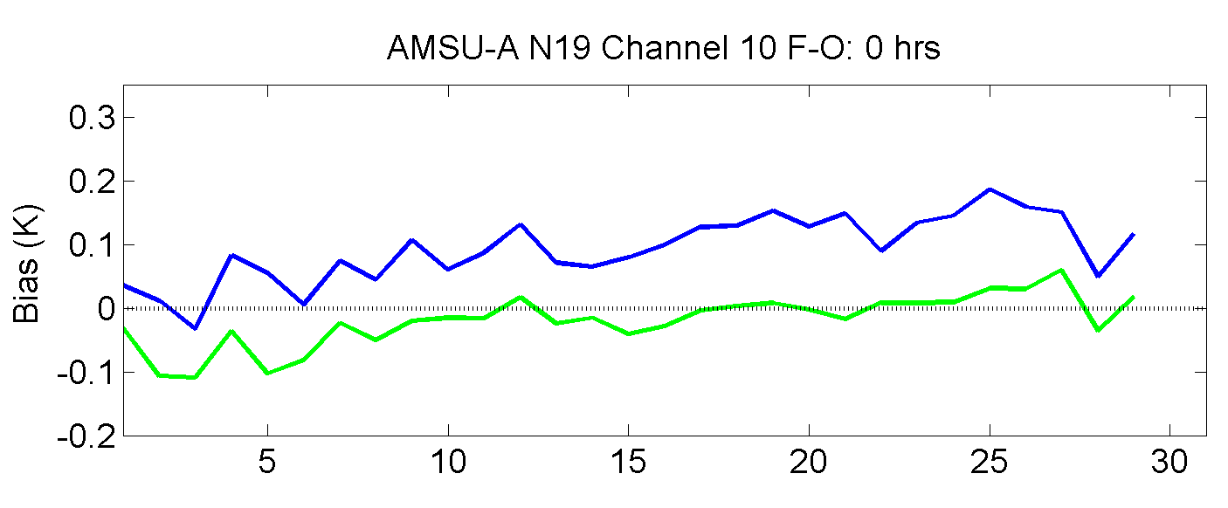
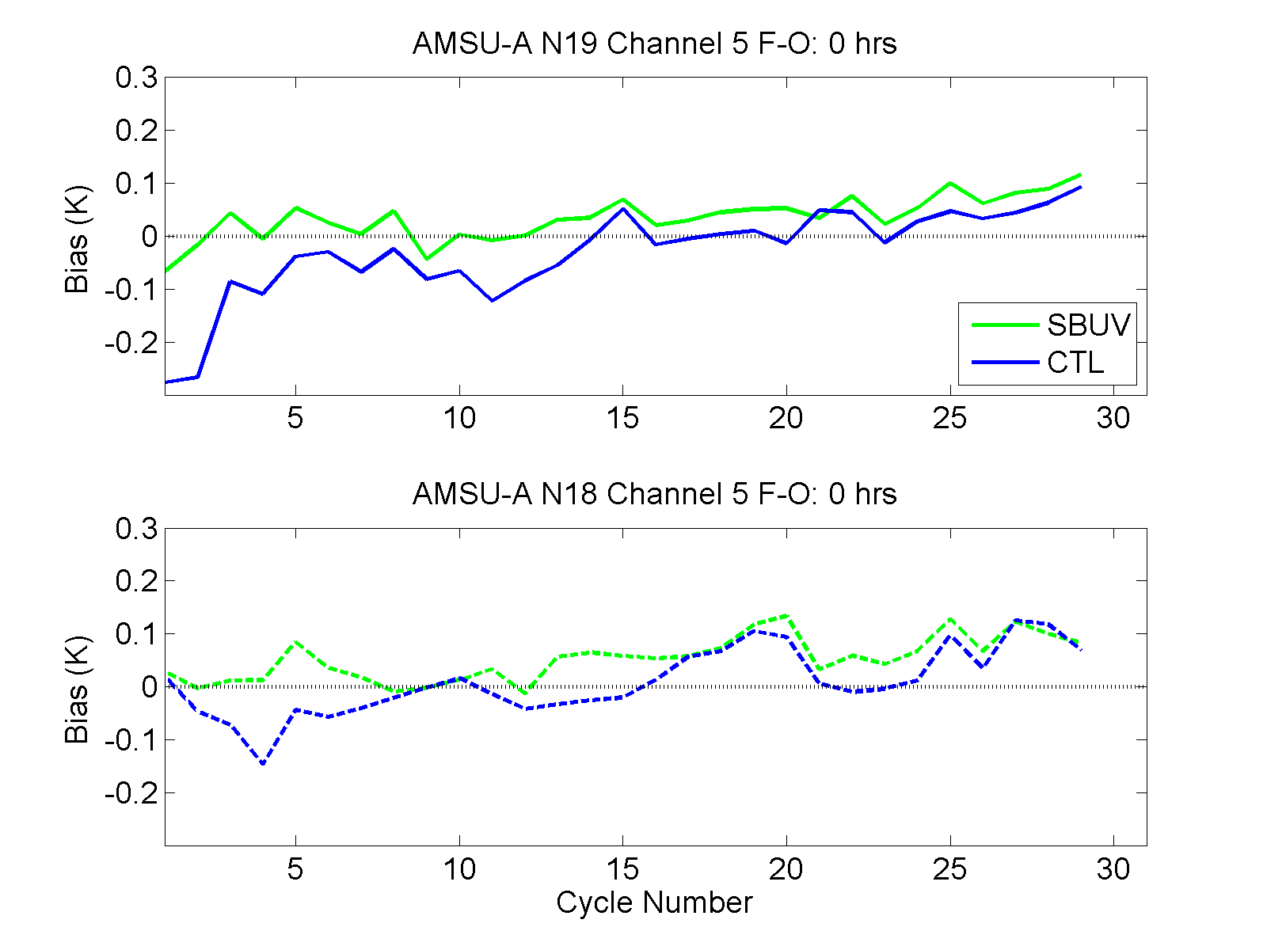
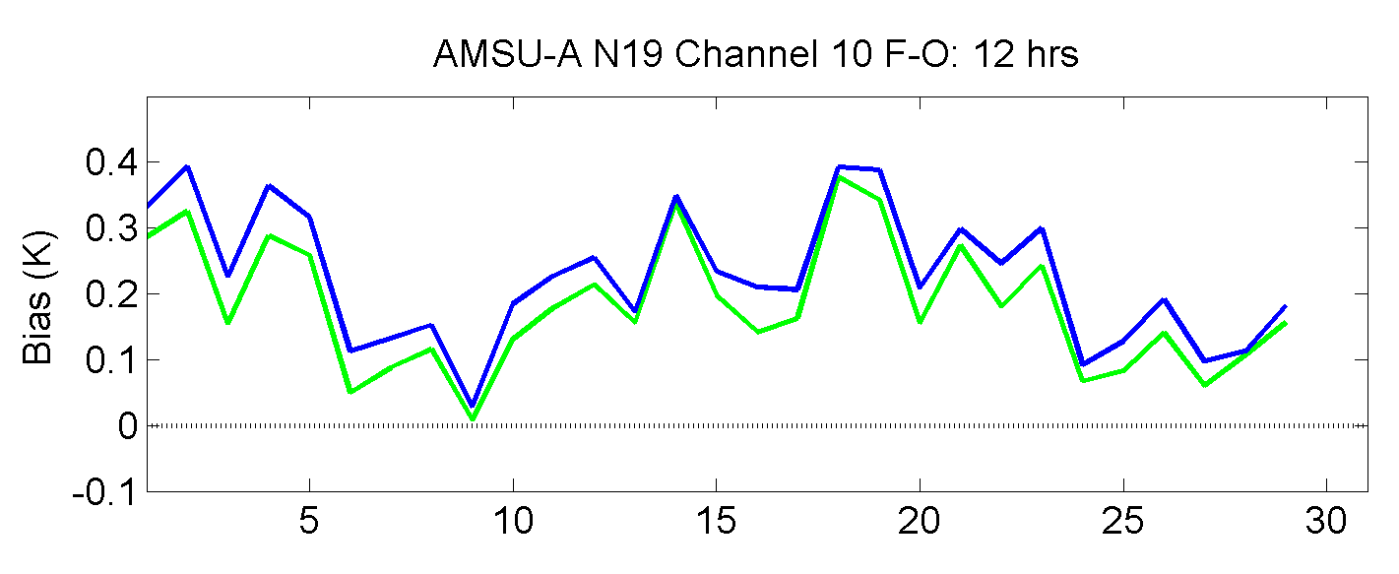
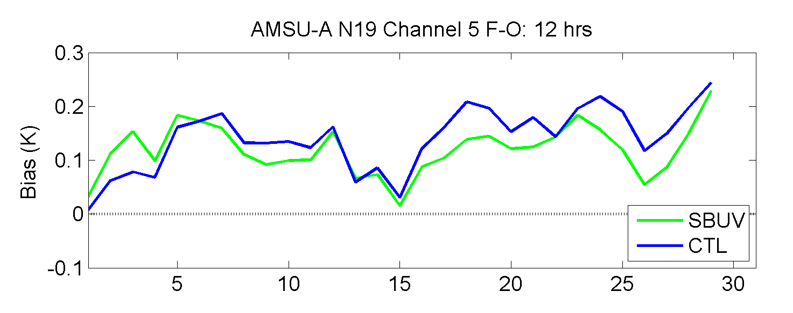
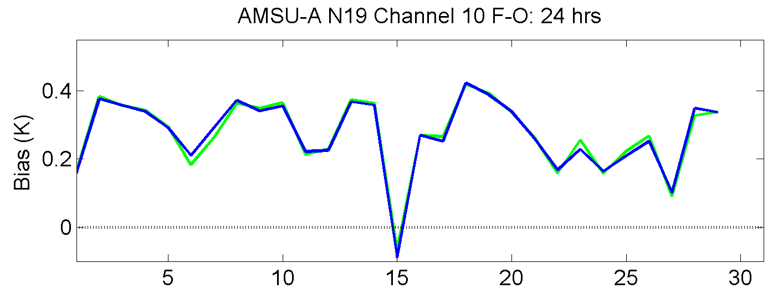
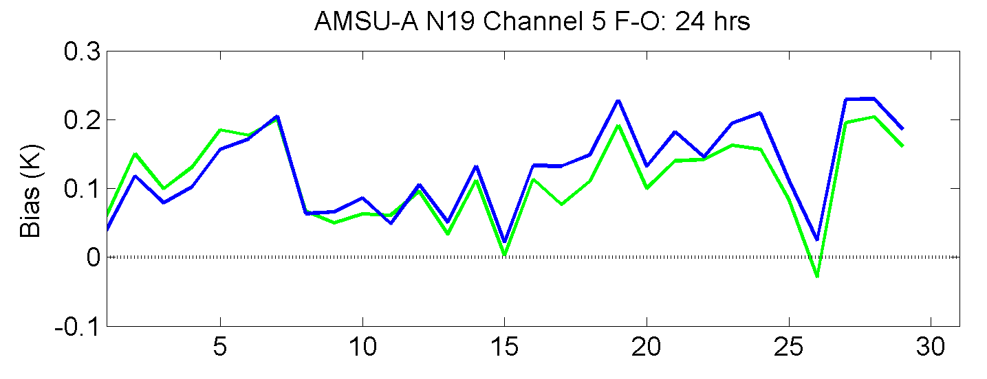
Forecast Bias
Analysis
12-hr
24-hr
Channel 10 AMSU-A:
  Strong signature of improvement from SBUV at analysis time. 12-hr forecast consistently smaller bias in SBUV. 24-hr differences negligible
Channel 5 AMSU-A:
  Improvement for SBUV at analysis time in first 15 days. 12-hr SBUV bias smaller after day 5. 24-hr forecast consistently smaller biases in SBUV.

Slide 16
Analysis Departure From AMSU-A
Channel 10: higher peaking, temperature sensitive
CTRL-AMSUA
SBUV-AMSUA
(SBUV-AMSUA)-(CTRL-AMSUA)
Consistent with large T improvements from SBUV at analysis time in upper levels

Slide 17
12-hr Forecast Departure from AMSU-A
Channel 10: higher peaking, temperature sensitive
CTRL-AMSUA
SBUV-AMSUA
(SBUV-AMSUA)-(CTRL-AMSUA)
Impact from SBUV assimilation still present for 12-hr forecast

Slide 18
24-hr Forecast Departure from AMSU-A
Channel 5: mid-level peak, temperature sensitive
Mid-level Temp bias reduction from SBUV configuration still evident at 24-hrs

Slide 19
Summary
Increasing model top from 10 hPa to 2 hPa presents overall improvement to analysis and forecasts
SBUV ozone were assimilated into GSI, GFS ozone used for background
  Only analysis update, indirect impact on radiances
Assimilating SBUV presents generally positive impacts
  Improved T analysis for most levels
  Wind improvements for short term forecasts (~18 hrs)
  Cooling pattern from SBUV, more consistent w/ observations & reanalysis

Slide 20
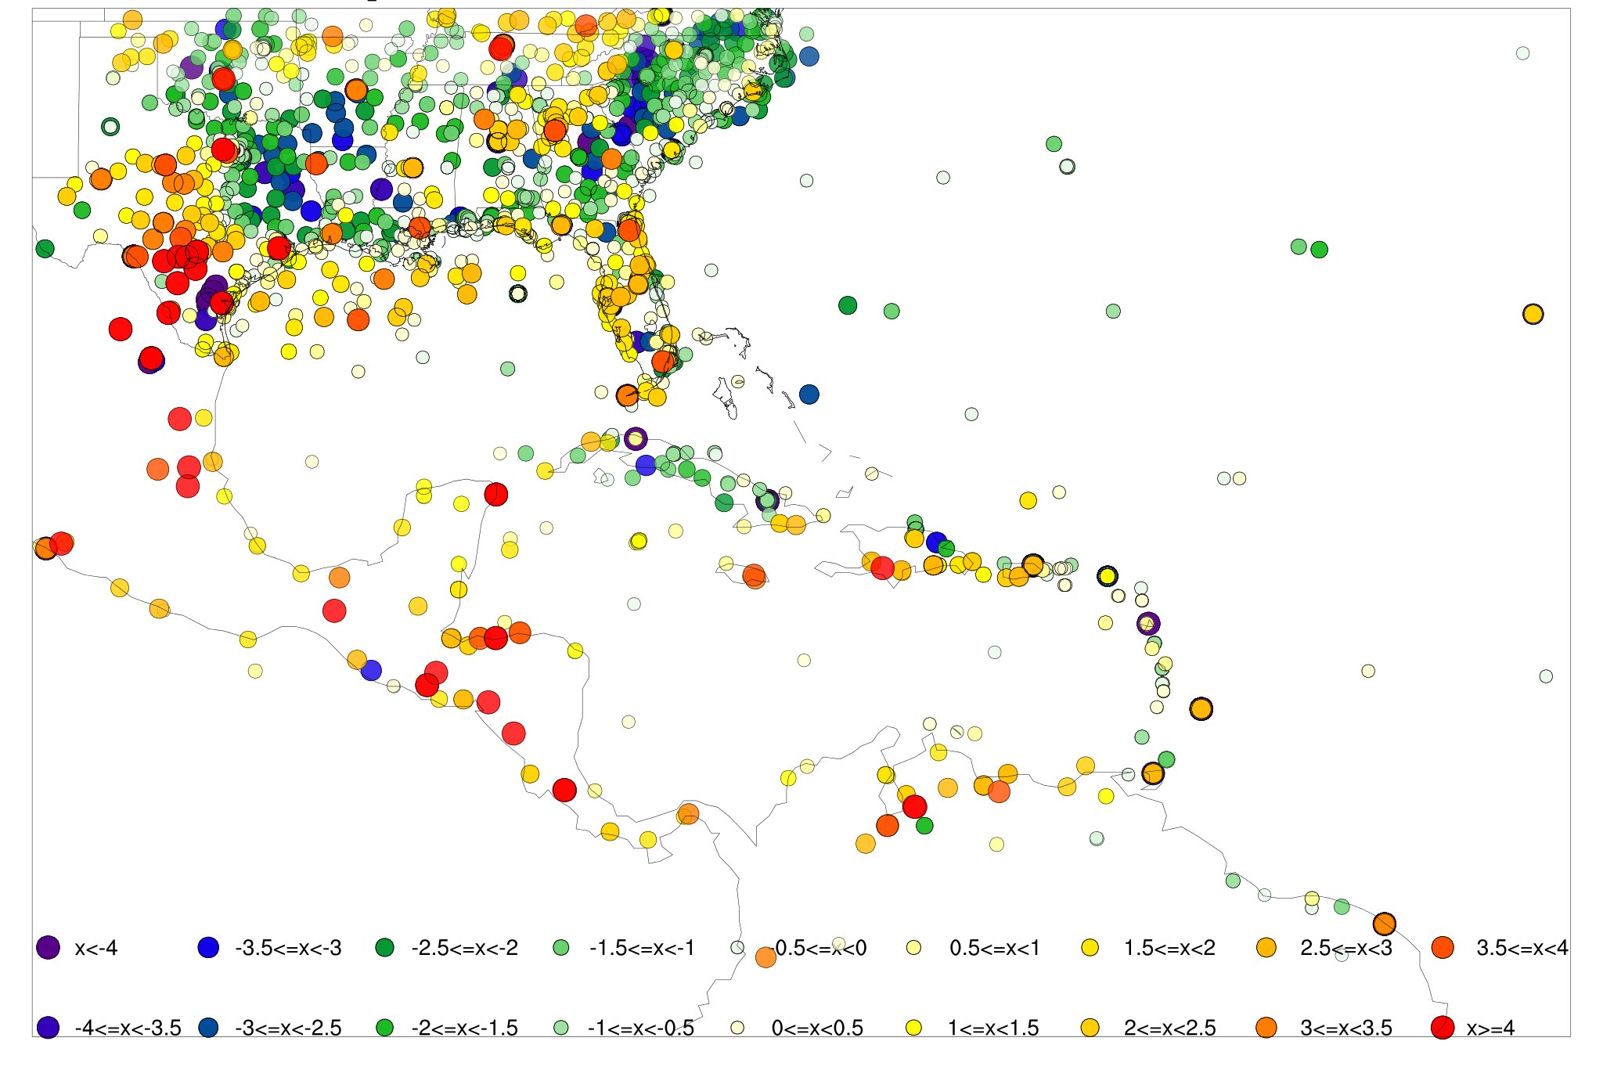
GSI Diagnostics in MET
Model Evaluation Tools (MET) v5.1 (planned release fall 2015) will include GSI diagnostics capabilities
Reformat binary GSI diagnostic output files (conv, rad)
Ability to threshold, filter, subset and produce statistics on diagnostic output
O-B: Conventional Temperature Obs
AMSU-A n19 Ch 10 O-B

